Slide 1
[Do not present this slide]
Disclaimer: The content in this presentation is Microsoft content. The content that appears on the slides may not be edited, copied, photographed, or changed.
Instructions: This deck is intended for skilling Microsoft Partner audiences only. These slides are not designed to be shared with customers. They are for Microsoft partner training/skilling/reference only.
Updated: Oct 2024

Slide 2
About this presentation
Title | AI-powered Use Cases and Technical Patterns for Key Organizational Functions
Summary | This deck provides high priority AI use cases for key organizational functions (also known as Rooms of the House). It is meant to help prioritize use cases for a customer and then link that business use cases to technical assets to facilitate implementation. These use cases were prioritized using three data sources, 1). Azure AI and Apps customer stories, 2). Sales engagements, 3.) External third-party research.
Version | 2.0 – September 2024
Notes:
Additional context for target audience
Data professionals could leverage this back-end solution accelerator to generate contact center reports for business decision makers
Customers with virtual assistant deployed in production​
If they are using the telemetry SDK from Bot Framework this is a zero effort startup​
If they are using a different bot platform it’s easy to adapt the pre-processing function to transform the data schema​
Customers with mid to big size contact centers​
For chat logs the solution accelerator is ready to use​
For call recordings we can deploy the solution accelerator from the Speech team for Batch Transcription
Source
https://microsofteur-my.sharepoint.com/:p:/g/personal/fruocco_microsoft_com/ESc1hdomiC9PnFnKQPSs7moB6dKakbDnBTaDrViHUx11vg?e=QxjHyc
CELA disclaimer
"Terms displayed or discussed are for explanation/education only. Such terms may differ from your agreement."

Slide 3
AI-powered Use Cases and Technical Patterns for Key Organizational Functions
Guide for Azure sellers

Slide 4
What’s in this playbook
Organizational Function (Room of the House)
Azure
AI-enabled Business Use Cases
Related Customer Stories
Supporting Technical Patterns / Architecture

Slide 5
At-a-Glance: Rooms of the House for Azure AI Apps
Room of the House | Top AI-enabled Business Use Cases | Customer Examples
Head of Product | AI-enabled product experiences: Virtual assistant, document automation, content creation Research at scale to inform product design Rapid design and prototyping | Mercedes Benz,Tomtom, Lucy, RxHealth, Coats Digital, Dominos, Instacart
Legal | Summarization of legal precedents or docs for litigation support Automating contract creation, review and management Real-time tracking of changing laws and regulations impacting policy | Relativity, Linklaters, Addleshaw Goddard, Allen & Overy, Clifford Chance, FRONTEO
Customer Service and Contact Centers | Customer self-service assistant Contact center agent assistant Call summarization and analytics | Windstream, ERGO Insurance, Manulife / John Hancock, Akbank, Ally Bank
Marketing | Shopping assistant / product recommendation and upsell Auto-generate personalized marketing content Customer micro-segmentation Conversational / adaptive customer research surveys | IHIS, ASOS, Coles, Telefonica, Progressive, NBA, CarMax, Westnet
IT/Software Development | IT and developer documentation, knowledge management AI-enabled application development and modernization Infrastructure-as-Code for service automation | AT&T, Siemens
HR | Recruitment process automation Employee self-service and knowledge management Personalized career planning | Windstream, Airbus, Moveworks, Arthur D. Little, Heineken

Slide 6
Get to know the Chief Product Officer
Who to target
Product experience lead
Product design lead
Product management lead
Top AI use-cases
AI-enabled product experiences
Virtual assistant for customers and partners
Document and workflow automation
Creation of new customer-facing content
Research at scale to inform product strategy
Mine existing data or knowledge databases at scale to inform product strategy and requirements
Rapid design and prototyping
Develop user interfaces, user experiences and multi-media assets that enable and enhance end user interactions with digital solutions
Motivations and desired outcomes
Drive business growth and competitive differentiation through product quality and experiences
Accelerate time-to-market of new product offerings
Reduce IP vulnerability to security threats
Reduce R&D and new product launch costs
Our value proposition
Create differentiated product experiences enabled by AI and generative AI
Develop a more efficient product innovation (research, modeling and prototyping) process
Monetize your own product copilot solutions to generate new revenue sources

Slide 7
Business Impact
PERSONA Product experience lead
Customer Impact | Risk Level | Ease of Implementation
High | High | High
Medium | Medium | Medium
Low | Low | Low
Metrics
Customer satisfaction
Cost savings
Virtual assistant for customers and partners
A virtual assistant responds to customer questions, offers product recommendations, or guides users through a task. With generative AI, it uses known data sets and past successful outcomes to generate a natural language response and can provide personalization based on a customer’s profile.
Digital assistants can also be used to help partners navigate product documentation, find parts, or automate basic transactions.
Benefits
Improve customer satisfaction by providing faster, self-service resolution of requests
Reduce labor costs
Improve organizational learning through the ongoing review/analysis of customer requests
Technical Patterns and Sample Architectures
Build your own custom copilot
Technical Capabilities and Products*
Azure AI Services
Azure App Service / Azure Kubernetes Service / Azure Container Apps
Azure Cosmos DB / Azure PostgreSQL / Azure SQL Hyperscale
Microsoft Fabric
Azure Machine Learning Prompt Flow
Semantic Kernel / Langchain
Azure API Management
Customer examples
TomTom created Digital Cockpit, a fully integrated, AI-powered, conversational automotive assistant that enables more sophisticated voice interaction with infotainment, location search, and vehicle command systems.
Unity
Sapiens
Mercedes Benz
RxHealth
Coats Digital
*not exhaustive

Slide 8
Business Impact
PERSONA Product experience lead
Customer Impact | Risk Level | Ease of Implementation
High | High | High
Medium | Medium | Medium
Low | Low | Low
Metrics
Reduced cycle time
Headcount per doc
Document and workflow automation
With generative AI, product owners can automate document capture, analysis and routing to accelerate transaction processing and offer differentiated service delivery.
Smart approval routing is done by analyzing past transactions, approval patterns, and budget allocations to predict the most efficient approval routing for new requests. This intelligent routing considers factors like transaction category, customer history, and spending thresholds to direct requests to the appropriate approvers, eliminating unnecessary delays.
Technical Patterns and Sample Architectures
Document processing & summarization
Technical Capabilities and Products*
Azure OpenAI Service
Azure App Service / Azure Kubernetes Service / Azure Container Apps
Azure Cosmos DB / Azure PostgreSQL / Azure SQL Hyperscale
Azure Form Recognizer
Azure AI Document Intelligence
Azure API Management
Azure Blob Storage
Azure Functions
Customer examples
H&R Block tax professionals use AI to find detailed client history, pull information from stacks of forms, and summarize account status.
Intapp
AGMC
Kry
iCertis
Astronomer
KPMG
Thread
Manulife
Aprimo
*not exhaustive

Slide 9
Business Impact
PERSONA Product experience lead
Customer Impact | Risk Level | Ease of Implementation
High | High | High
Medium | Medium | Medium
Low | Low | Low
Metrics
Net new customers
Revenue increase
Creation of new customer-facing content
Product owners can generate new content formats from existing content (i.e. text, images, videos) by reformatting, resizing, clipping or transforming the source item into a variety of new forms.
These new content formats can become a new source of revenue, or help you reach new audiences and expand your customer base.
Technical Patterns and Sample Architectures
Content generation
Technical Capabilities and Products*
Azure OpenAI Service
Azure App Service / Azure Kubernetes Service / Azure Container Apps
Azure Cosmos DB / Azure PostgreSQL / Azure SQL Hyperscale
Azure API Management
Azure Functions
Customer examples
Le Monde used Azure AI to provide its audience the option of listening to Le Monde rather than reading it, in order to retain subscribers by adapting to their new ways of consuming news.
Promo.com
DeepBrain AI
*not exhaustive

Slide 10
Business Impact
PERSONA Product management lead
Metrics
Accelerate time-to-market
Higher NPI (New Product Introduction) success
Customer Impact | Risk Level | Ease of Implementation
High | High | High
Medium | Medium | Medium
Low | Low | Low
Research at scale to inform product design
Product managers can use generative AI to conduct research at scale for prioritizing new product features and enhancements.
With generative AI you can evaluate/summarize internal signals such as service reports, customer support transcripts, feature/change requests, as well as external signals such as social media feeds, industry news, and government regulations to deliver a comprehensive, prioritized list of product requirements.
Benefits
Accelerate time-to-market and increase success of new product introductions (NPI).
Reduce risk of non-compliant products and cost of recalls and re-design.
Technical Patterns and Sample Architectures
Knowledge mining
Document processing & summarization
Technical Capabilities and Products*
Azure OpenAI Service
Azure AI Search
Azure App Service / Azure Kubernetes Service / Azure Container Apps
Azure Cosmos DB / Azure PostgreSQL / Azure SQL Hyperscale
Azure Document Intelligence
Azure Blob Storage
Azure API Management
Azure Functions
Customer examples
Paytronix
CIPIO.ai enables its customers to search for on-brand content in seconds, with over 12 million creators and 300 million videos and images refreshing in real-time.
*not exhaustive

Slide 11
Business Impact
PERSONA Product development lead
Customer Impact | Risk Level | Ease of Implementation
High | High | High
Medium | Medium | Medium
Low | Low | Low
Metrics
Reduce time-to-market
Increase product quality and CSAT
Rapid UX/UI design and prototyping
Product designers can use generative AI to accelerate the development of user interfaces, user experiences and multi-media assets that enhance end-user interactions with digital products.
Benefits
Faster time-to-market of solutions
Improved customer satisfaction
Higher end-user engagement
Technical Patterns and Sample Architectures
Content generation
Technical Capabilities and Products*
Azure OpenAI Service
Azure App Service / Azure Kubernetes Service / Azure Container Apps
Azure Cosmos DB / Azure PostgreSQL / Azure SQL Hyperscale
Azure API Management
Azure Functions
Customer examples
Intapp uses Azure OpenAI to deliver configurable UX blueprints to get a firm up and running quicker with out-of-the-box configurations for the specifics of professional and financial services firms.
*not exhaustive

Slide 12
Get to know Legal
Who to target
Legal counsel
Risk management and compliance lead
Contract management lead
Top AI use-cases
Summarization and e-Discovery
Summarize legal precedent to support legal arguments
Speed up review of complex documents to reduce litigation prep time
Automating contract creation, review and management
AI-enabled review of third-party contracts
Contract repository management and risk tracking
Draft contracts using pre-approved templates and clause libraries
Policy tracking and change management
Track relevant laws and regulations to facilitate real-time policy changes
Motivations and desired outcomes
Understand business strategy and reflect it in legal strategy
Serve as a trusted business advisor who proactively engages management and the board on strategic business issues
Anticipate and address changes in regulatory requirements and public policy
Our value proposition
Save time while conducting a more thorough search and analysis of extensive legal databases
Reduce cost and enable employees to focus on higher-value work by automating contract creation and management processes
Mitigate risks by addressing changes in regulatory requirements more quickly

Slide 13
Business Impact
PERSONA Legal counsel
Customer Impact | Risk Level | Ease of Implementation
High | High | High
Medium | Medium | Medium
Low | Low | Low
Metrics
Accuracy
Time savings
Cost savings
Summarization and e-Discovery
Legal teams can use generative AI to do extensive research and summarize relevant case law and legal precedents to support legal arguments. Users can search and digest relevant case law and even input case details to generate responses specific to their controversy.
In litigation, e-Discovery with generative AI can improve review efficiency by speeding document comprehension through quick summarization of documents. Documents that would take hours to view can be distilled quickly.
Benefits
Increase efficiency of reviews
Minimize reviewer fatigue
Technical Patterns and Sample Architectures
Knowledge mining
Document processing & summarization
Technical Capabilities and Products*
Azure OpenAI Service
Azure AI Search
Azure App Service / Azure Kubernetes Service / Azure Container Apps
Azure Cosmos DB / Azure PostgreSQL / Azure SQL Hyperscale
Azure Document Intelligence
Azure Blob Storage
Azure API Management
Azure Functions
Customer examples
Clifford Chance uses AI to create content from key internal sources while maintaining high levels of security and confidentiality.
Relativity
Linklaters
Addleshaw Goddard
Allen & Overy
FRONTEO
*not exhaustive

Slide 14
Business Impact
PERSONA Contract management lead
Customer Impact | Risk Level | Ease of Implementation
High | High | High
Medium | Medium | Medium
Low | Low | Low
Metrics
Time savings
Cost savings
Risk mitigation
Automating contract creation, review and management
With generative AI, contract management teams can automate the drafting of contracts using pre-approved templates and clause libraries, as well as automate first-pass reviews of contracts highlighting redline mark-ups, compliance requirements, negotiation points and alternative clauses based on existing clause libraries and extensive playbooks.
Users can also search through contracts for critical clauses, measure portfolio risk, and help ensure that contracts are within risk metrics. If desired, you can even design the system to trigger renewal workflows automatically.
Technical Patterns and Sample Architectures
Document processing & summarization
Custom copilot
Technical Capabilities and Products*
Azure OpenAI Service
Azure Document Intelligence
Azure App Service / Azure Kubernetes Service / Azure Container Apps
Azure Cosmos DB / Azure PostgreSQL / Azure SQL Hyperscale
Azure Form Recognizer
Azure Blob Storage
Azure API Management
Azure Functions
Azure Machine Learning Prompt Flow
Semantic Kernel / Langchain
Customer examples
iCertis built its Icertis Contract Intelligence (ICI) Copilots on Azure, which guides legal users to focus on problematic terms and earmarks contracts that don’t require further review, enabling enterprises to more effectively manage risk.
*not exhaustive

Slide 15
Business Impact
PERSONA Legal counsel
Customer Impact | Risk Level | Ease of Implementation
High | High | High
Medium | Medium | Medium
Low | Low | Low
Metrics
Risk mitigation
Time savings
Policy tracking and change management
With generative AI, legal teams can automate the tracking of changing laws and regulations affecting line of business users, alert them to the changes as well as implement policy changes in real-time.
This enables the team to better respond to regulatory changes and improve risk posture by removing human error from the equation.
Technical Patterns and Sample Architectures
Knowledge mining
Technical Capabilities and Products*
Azure OpenAI Service
Azure AI Search
Azure App Service / Azure Kubernetes Service / Azure Container Apps
Azure Cosmos DB / Azure PostgreSQL / Azure SQL Hyperscale
Azure Machine Learning
Semantic Kernel / Langchain
Azure API Management
Customer examples
Grupo Bimbo created a copilot for internal control and risk management to promote compliance within Grupo Bimbo’s policies, which apply to all Bimbo collaborators in the 34 countries where they have a presence.
*not exhaustive

Slide 16
Get to know Customer Service
Who to target
Head of Customer Service Operations
Head of Contact Center
Top AI use-cases
Customer self-service assistant
Knowledge base search and digital self-service assistants
Contact center agent assistant
Contact center agent knowledge management
Real-time resolution recommendation
Call summarization and analytics
Call summarization for customers
Call summarization for internal reporting and analytics
Motivations and desired outcomes
Deliver seamless customer experiences across channels
Grow revenue and improve customer satisfaction
Provide employees with focused insights to help drive key actions
Reduce employee turnover in service and support
Our value proposition
Improve customer self-service through faster access to relevant knowledge
Automate repetitive, manual tasks to free up human resources for higher-value activities
Empower agents with AI-driven issue resolution and next-best action support

Slide 17
Business Impact
PERSONA Head of Customer Service
Customer Impact | Risk Level | Ease of Implementation
High | High | High
Medium | Medium | Medium
Low | Low | Low
Metrics
Improved NPS / CSAT
Contact center deflection rate
Customer self-service assistant
With generative AI, customers can search through the company knowledge base with a natural language interface, and receive personalized responses based on their profile, historical data, or other factors.
In addition, digital assistants can help customers successfully complete tasks or resolve issues without needing to talk to an agent.
These capabilities enable the organization to deliver efficient self service, increase customer satisfaction and reduce contact center agent workload.
Technical Patterns and Sample Architectures
Build your own custom copilot
Technical Capabilities and Products*
Azure AI Services
Azure App Service / Azure Kubernetes Service / Azure Container Apps
Azure Cosmos DB / Azure PostgreSQL / Azure SQL Hyperscale
Microsoft Fabric
Azure Machine Learning Prompt Flow
Semantic Kernel / Langchain
Azure API Management
Customer examples
John Hancock’s conversational virtual assistant provided customers with self-service options 24 hours a day, seven days a week, 365 days a year, and enabled the company to manage the surge in customer calls during the COVID pandemic.
ERGO Insurance
EPIC
*not exhaustive

Slide 18
Business Impact
PERSONA Head of Contact Centers
Metrics
Increase first interaction resolution
Improve customer effort score
Customer Impact | Risk Level | Ease of Implementation
High | High | High
Medium | Medium | Medium
Low | Low | Low
Contact center agent assistant
With generative AI, you can provide contact center agents with a conversational chatbot surfacing relevant knowledge articles to accelerate issue resolution, as well as proactive response recommendations based on previous similar cases.
In addition, an AI-enabled system can suggest new knowledge articles from responses, identify knowledge gaps, and create articles to fill those gaps.
This can reduce latency, reduce errors in out-of-date knowledge articles, identify articles still relevant and target gaps to increase response accuracy and reduce customer frustration.
Technical Patterns and Sample Architectures
Build your own custom copilot
Knowledge mining
Technical Capabilities and Products*
Azure OpenAI Service
Azure Cognitive Services
Azure App Service / Azure Kubernetes Service / Azure Container Apps
Azure Cosmos DB / Azure PostgreSQL / Azure SQL Hyperscale
Microsoft Fabric
Azure Machine Learning Prompt Flow
Semantic Kernel / Langchain
Azure API Management
Customer examples
Telstra’s in-house “Ask Telstra” and “One Sentence Summary” copilots for call center agents yielded a 20 percent reduction in follow-up calls than those handled without the tools.
Windstream
Akbank
*not exhaustive

Slide 19
Business Impact
PERSONA Head of Contact Centers
Metrics
Increase customer satisfaction (CSAT)
Increase agent productivity
Customer Impact | Risk Level | Ease of Implementation
High | High | High
Medium | Medium | Medium
Low | Low | Low
Call summarization and analytics
With generative AI, you can enable real-time call summarization for internal reporting and analytics. Automated summarization can deliver significant time savings for agents, and using the data for analysis can help identify trending issues and document agent best practices.
In addition, you can provide real-time call summarization to customers after a contact center or chatbot interaction. If desired, you can even include personalized recommendations on offers and content.
Technical Patterns and Sample Architectures
Document processing & summarization
Knowledge mining
Technical Capabilities and Products*
Azure OpenAI Service
Azure Cognitive Services
Azure App Service / Azure Kubernetes Service / Azure Container Apps
Azure Cosmos DB / Azure PostgreSQL / Azure SQL Hyperscale
Azure Speech to Text
Azure Machine Learning Prompt Flow
Azure API Management
Customer examples
Ally Financial automated call summarization for its contact center associates, empowering them to deliver a better, more personal experience while protecting vital customer data.
Windstream
AT&T
CallMiner
*not exhaustive

Slide 20

Get to know Marketing
Who to target
Head of Marketing Operations
Head of Customer Acquisition / Customer Engagement
Top AI use-cases
Personalized shopping assistant
Proactive shopping guides, order updates, and targeted offers that deliver personalized actions across the customer journey
AI-enabled marketing content generation
Create marketing assets based on goal-oriented narratives from marketers
Continuous customer micro-segmentation
Use real-time behavioral signals and other data to optimize audience activation for campaigns
Conversational / adaptive customer research surveys
Create conversational, dynamic surveys that adapt in real-time based on participant responses
Motivations and desired outcomes
Acquire new customers and maximize sales
Provide tailored interactions that customers value
Create stickiness in products and offerings
Reduce operational costs and accelerate time-to-market
Boost productivity through automated workflows
Our value proposition
Gain AI-driven market insights and customer segmentation
Elevate your product/brand position with differentiated digital experiences
Facilitate product upsell with personalized customer journeys
Use generative AI to create new marketing assets at scale and apply AI responsibly

Slide 21
Business Impact
PERSONA Head of Customer Engagement
Customer Impact | Risk Level | Ease of Implementation
High | High | High
Medium | Medium | Medium
Low | Low | Low
Metrics
Increase CSAT
Reduce customer effort score
Personalized shopping assistant
With generative AI, you can build a digital assistant to increase customer engagement and differentiate your brand experience. A digital assistant interacts with customers in natural language to answer questions, offer product recommendations, or guide customers through their shopping journey based on their profile, known data sets, and past successful outcomes.
Benefits
Reduce marketing, sales and customer support costs with smart, intelligent self-service
Elevate your brand with an enhanced shopping experience
Help generate incremental revenue through personalized product upsell
Technical Patterns and Sample Architectures
Build your own custom copilot
Personalized recommendations
Technical Capabilities and Products*
Azure OpenAI Service
Azure App Service / Azure Kubernetes Service / Azure Container Apps
Azure Cosmos DB / Azure PostgreSQL / Azure SQL Hyperscale
Microsoft Fabric
Azure Machine Learning
Semantic Kernel / Langchain
Azure API Management
Customer examples
Etsy’s new AI-powered shopping assistant helps customers navigate items by making product recommendations. ’Gift Mode,’ a new AI-powered feature, generates 200+ gift guides.
IHIS
ASOS
Coles
Telefonica
Progressive
*not exhaustive

Slide 22
Business Impact
PERSONA Head of Marketing Operations
Customer Impact | Risk Level | Ease of Implementation
High | High | High
Medium | Medium | Medium
Low | Low | Low
Metrics
Time to market
Cost per campaign
Number of campaigns
AI-enabled marketing content generation
With generative AI, marketing teams can automate the creation of web content (such as individual product descriptions for an online catalog) or generate visual campaign creative assets based on goal-oriented narratives from marketers.
The ability to deliver dynamic material enables marketers to provide up-to-date content in real time, while significantly accelerating time-to-market of campaigns and reducing production and labor costs.
Technical Patterns and Sample Architectures
Content generation
Technical Capabilities and Products*
Azure OpenAI Service
Azure App Service / Azure Kubernetes Service / Azure Container Apps
Azure Cosmos DB / Azure PostgreSQL / Azure SQL Hyperscale
Azure API Management
Azure Functions
Customer examples
Carrefour is using Azure OpenAI to enrich its brand product sheets, describing products and providing customers with more information. With more than 2,000 products now online, Carrefour plans to use this technology for all its product sheets.
Orange Group
Boyner
NBA
CarMax
Westnet
*not exhaustive

Slide 23
Business Impact
PERSONA Head of Customer Acquisition
Metrics
Reduce customer acquisition cost
Increase campaign effectiveness across audiences
Customer Impact | Risk Level | Ease of Implementation
High | High | High
Medium | Medium | Medium
Low | Low | Low
Continuous customer micro-segmentation
With generative AI, marketing teams can enable continuous evaluation of segment membership based on real-time behavioral signals, as well as other customer transactional data and customer data attributes to optimize audience targeting and activation for campaigns and offers.
This can improve marketing effectiveness with increased accuracy of targeting and the ability to deliver more personalized marketing messages.
Technical Patterns and Sample Architectures
Personalized recommendations
Technical Capabilities and Products*
Azure Machine Learning
Azure App Service / Azure Kubernetes Service / Azure Container Apps
Azure Cosmos DB / Azure PostgreSQL / Azure SQL Hyperscale
Azure API Management
Azure Functions
Customer examples
Yobi partners with Microsoft to democratize responsible enterprise access to customer behavioral data
Otocash.com
Selfhelp
*not exhaustive

Slide 24
Business Impact
PERSONA Head of Marketing Operations
Customer Impact | Risk Level | Ease of Implementation
High | High | High
Medium | Medium | Medium
Low | Low | Low
Metrics
Quality of insight
Cost per survey
Conversational / adaptive customer research surveys
With generative AI, marketers can create conversational, dynamic customer surveys that adapt in real-time based on participant responses. If a respondent shows expertise or interest in a specific topic, the survey can dynamically adjust to delve deeper into that area.
This ensures a more engaging and personalized experience for participants, leading to more accurate and meaningful data to inform marketing strategy or to enhance customer experiences across all touchpoints in the customer journey.
Technical Patterns and Sample Architectures
Knowledge mining
Build your own custom copilot
Technical Capabilities and Products*
Azure OpenAI Service
Azure App Service / Azure Kubernetes Service / Azure Container Apps
Azure Cosmos DB / Azure PostgreSQL / Azure SQL Hyperscale
Azure AI Services
Azure Machine Learning
Semantic Kernel / Langchain
Azure API Management
Azure Functions
*not exhaustive
Notes:
Redefining insights: Innovations in survey design with AI - CleverX Blog

Slide 25



Get to know Software Development and IT Ops
Who to target
Chief Technology Officer
Chief Information Officer
Head of Enterprise Architecture
Head of Application Development / Software Engineering
Top AI use-cases
IT and developer knowledge management
Generate and maintain code documentation
Deliver step-by-step troubleshooting procedures by pulling data from multiple manuals and combining with support databases
AI-enabled application modernization and code development
Use GenAI to modernize legacy applications or generate code to accelerate new app development
Infrastructure as Code generation for service automation
Create and update IaC automation templates and playbooks based on existing manual process documentation or vendor provided updates
Motivations and desired outcomes
Application quality, performance, uptime
Solution time-to-market
Developer productivity
Our value proposition
Reduce operational cost
Increase app availability, performance, and security in the cloud
Rapidly respond to business needs and deliver value

Slide 26
Business Impact
PERSONA Head of Application Development
Customer Impact | Risk Level | Ease of Implementation
High | High | High
Medium | Medium | Medium
Low | Low | Low
Metrics
Accelerate mean-time-to-diagnose issues
Increase developer productivity
IT and developer knowledge management
With generative AI, software teams can generate and maintain code documentation or enhance existing documentation for better readability across teams.
You can build an app to deliver configuration-specific interactive, step-by-step troubleshooting procedures by pulling data from multiple manuals/documents and combining with support databases.
Benefits
Accelerated resolution of application-related bugs and issues
Accelerated onboarding of new developers
Augmented ability to transition development-related work to other teams and third-parties
Reduced time and cost of creating, distributing, and updating documentation and improve the speed and quality of service/support.
Technical Patterns and Sample Architectures
Code generation and documentation
Chat with your data
Technical Capabilities and Products*
GitHub Copilot
Azure App Service / Azure Kubernetes Service / Azure Container Apps
Azure Cosmos DB / Azure PostgreSQL / Azure SQL Hyperscale
Azure OpenAI Service
Azure AI Search
Semantic Kernel / Langchain
Azure API Management
Customer examples
AT&T used Microsoft Azure OpenAI Service to create an AI assistant, Ask AT&T, which helps its developers automate their coding process.
*not exhaustive

Slide 27
Business Impact
PERSONA Head of Application Development
Customer Impact | Risk Level | Ease of Implementation
High | High | High
Medium | Medium | Medium
Low | Low | Low
Metrics
Time to market
Developer productivity
Time to restore service
AI-enabled application modernization and code development
Generative AI can be used to update legacy software to take advantage of more modern infrastructures, languages, frameworks and hosting environments.
It can also be used to assist in developing code for net new applications. This allows organizations to focus their effort on creating proprietary code that differentiates them from competition.
Benefits
Increased developer velocity
Accelerated innovation
Improved customer satisfaction
Improved end user satisfaction
Expedited time to market
Technical Patterns and Sample Architectures
Code generation and documentation
Technical Capabilities and Products*
GitHub Copilot
Azure App Service / Azure Kubernetes Service / Azure Container Apps
Azure Cosmos DB / Azure PostgreSQL / Azure SQL Hyperscale
Azure OpenAI Service
Azure AI Search
Semantic Kernel / Langchain
Azure API Management
Customer examples
AT&T is using Azure OpenAI to migrate legacy code into modern code, which will help accelerate developers’ productivity and let them to focus on creating more modern tools and experiences for AT&T customers and employees
*not exhaustive

Slide 28
Business Impact
PERSONA Head of Application Development
Customer Impact | Risk Level | Ease of Implementation
High | High | High
Medium | Medium | Medium
Low | Low | Low
Metrics
App availability
Developer productivity
Infrastructure as Code generation for service automation
With generative AI, software and ops teams can create and update infrastructure as code automation templates and playbooks based on existing manual process documentation or vendor-provided updates.
This allows organizations to more quickly and broadly scale software-driven infrastructure management to reduce costs and errors and improve service levels.
Reduces downtime due to human error
Reduces cost of operations
Reduces business risk by ensuring more consistent configuration and security compliance and reporting
Technical Patterns and Sample Architectures
Code generation and documentation
Technical Capabilities and Products*
GitHub Copilot
Azure App Service / Azure Kubernetes Service / Azure Container Apps
Azure Cosmos DB / Azure PostgreSQL / Azure SQL Hyperscale
Azure OpenAI Service
Azure AI Search
Semantic Kernel / Langchain
Azure API Management
Customer examples
Modern Requirements used Generative AI to enable automation in many additional phases in the product development life cycle that are mundane and lets users focus more on the analytical and collaborative tasks that they have been trained for.
Siemens
*not exhaustive

Slide 29
Get to know Human Resources
Who to target
VP of Human Resources
Head of Recruitment and Talent Acquisition
Head of HR Operations
Head of Employee Experience
Top AI use-cases
Recruitment process automation
Requisition generation
Resume selection
Employee self-service and knowledge management
Enable employees to quickly find tools, resources, and insights they need in their flow of work
Personalized career planning
Create and update IaC automation templates and playbooks based on existing manual process documentation or vendor provided updates.
Motivations and desired outcomes
Improve quality of hire and reduce cost per hire
Increase employee retention rate, minimize turnover rate
Increase employee satisfaction and engagement
Our value proposition
Improve speed to alignment between prospects and final hire with AI-enabled recruitment
Increase employee productivity

Slide 30
Business Impact
PERSONA Head of Recruitment / Talent Acquisition
Customer Impact | Risk Level | Ease of Implementation
High | High | High
Medium | Medium | Medium
Low | Low | Low
Metrics
Speed to hire
Improved tenure metrics
Requisition generation and resume selection
Recruitment teams can use generative AI to assist in drafting job requisitions via natural language prompts and using existing data on business requirements.
Recruitment teams can also accelerate the resume screening process by integrating AI with the applicant tracking system, instantly scanning thousands of resumes to identify top candidates based on skills match and past job successes, significantly decreasing the time to hire, while managing potential human biases.
Technical Patterns and Sample Architectures
Build your own custom copilot
Technical Capabilities and Products*
Azure OpenAI Service
Azure App Service / Azure Kubernetes Service / Azure Container Apps
Azure Cosmos DB / Azure PostgreSQL / Azure SQL Hyperscale
Microsoft Fabric
Azure Machine Learning
Semantic Kernel / Langchain
Azure API Management
*not exhaustive

Slide 31
Business Impact
PERSONA Head of Employee Engagement
Customer Impact | Risk Level | Ease of Implementation
High | High | High
Medium | Medium | Medium
Low | Low | Low
Metrics
Employee productivity
Employee satisfaction
Employee self-service and knowledge management
With generative AI, HR teams can provide employees with a conversational chatbot or digital assistant surfacing relevant knowledge articles, insights, or tools they need in their line of work.
In addition, such a system can suggest new knowledge articles from responses, identify knowledge gaps, and create articles to fill those gaps.
Improved employee productivity
Faster internal knowledge transfer
Reduced task repetition and optimized task-time spend
Technical Patterns and Sample Architectures
Build your own custom copilot
Technical Capabilities and Products*
Azure OpenAI Service
Azure App Service / Azure Kubernetes Service / Azure Container Apps
Azure Cosmos DB / Azure PostgreSQL / Azure SQL Hyperscale
Microsoft Fabric
Azure Machine Learning
Semantic Kernel / Langchain
Azure API Management
Customer examples
Sweco developed SwecoGPT, a digital assistant to help its 22,000 consultants find critical project information quickly, create and analyze documents easily, and deliver more personalized service to customers around the world.
Fraport
Alpitour
Windstream
Airbus
Moveworks
Arthur D. Little
Heineken
*not exhaustive

Slide 32
Business Impact
PERSONA Head of Employee Engagement
Metrics
Employee satisfaction
Employee retention
Customer Impact | Risk Level | Ease of Implementation
High | High | High
Medium | Medium | Medium
Low | Low | Low
Personalized career planning
With generative AI, HR teams can auto-generate interactive career development pathways based on existing and prospective job requisitions, reconciled against employee development needs and goals.
This enables the organization to retain valuable talent, improve skills alignment to jobs, increase employee satisfaction, and reduce overall hiring costs.
Technical Patterns and Sample Architectures
Build your own custom copilot
Technical Capabilities and Products*
Azure OpenAI Service
Azure App Service / Azure Kubernetes Service / Azure Container Apps
Azure Cosmos DB / Azure PostgreSQL / Azure SQL Hyperscale
Microsoft Fabric
Azure Machine Learning
Semantic Kernel / Langchain
Azure API Management
*not exhaustive

Slide 33
Build your own custom copilot
A custom copilot for enterprise applications performs two things: 1) search/summarize data through a chat UI and/or 2) task completion within the enterprise app using private or public data.
The primary technical capabilities are generative AI, cognitive search, ML, orchestration and app dev. This pattern leverages the Microsoft Copilot Stack framework.

Slide 34













Reference Architecture: Custom copilot
Container Registry
App Service
Web Front-end to explore documents from different sources, and generate content
Storage Accounts
OR
AML Prompt Flow
Azure OpenAI Service
Microsoft Fabric Synapse Data Engineering Pipeline
Azure Database for PostgreSQL
OR
Orchestration and Evaluation in Azure Al Studio
Source Knowledge Repository
OneLake
Notebook
Azure Al Search
Azure SQL Database
OR
Storage Account Mounted to OneLake
Process, Enrich, Vectorize and Index
Indexed Knowledge Articles
Azure Cosmos DB
Load Documents for a Topic
Azure OpenAl Service
Azure Al Services
BYOAIA Solution Accelerator GitHub
Vector Search AI Assistant Solution Accelerator GitHub
Custom copilot
Also known as a “custom copilot”. A custom copilot for enterprise applications performs two things:
Search/summarize data through a chat UI and/or
Task completion within the enterprise app using private or public data.
Data may be read from a variety of data sources, including Storage Account, CosmosDB, Azure Database for PostgreSQL, or Azure SQL. An additional reference architecture can be found in the appendix.

Slide 35
Document Processing & Summarization
This technical pattern enables users to classify, extract, summarize, and gain deeper insights from documents using natural language prompts with high accuracy and limited-to-no machine learning (ML) training. It combines the capabilities of Azure Form Recognizer, AKS/App Service, CosmosDB/PostgreSQL/SQL Hyperscale, Azure ML.

Slide 36













Sample Architecture: Large Document Summarization
Azure
API Management
Storage Accounts
Function App
OR
Orchestration
Azure Database for PostgreSQL
OR
Summarize
data
Summarized Document
Extract
Azure SQL Database
Storage Accounts
User can see summaries of large documents in PowerApps application
OR
Upload triggers workflow
Large Document
Document chunks
Summarized chunks
Azure Cosmos DB
The API returns the requested summaries of the large documents
AI Document Intelligence
Azure
OpenAI Service
This technical pattern enables customers to conduct knowledge mining to gather information and gain valuable insights and patterns in aggregate over large repositories of documents
Data may be read from a variety of data sources, including Storage Account, CosmosDB, Azure Database for PostgreSQL, or Azure SQL
Knowledge Mining
Notes:
Inspired By: Telecomm

Slide 37
Knowledge Mining
This technical pattern enables customers to conduct large scale knowledge mining to find information and gain valuable insights and patterns. It combines knowledge mining (the cog service), RAG, with generative AI augmented at the front end.

Slide 38
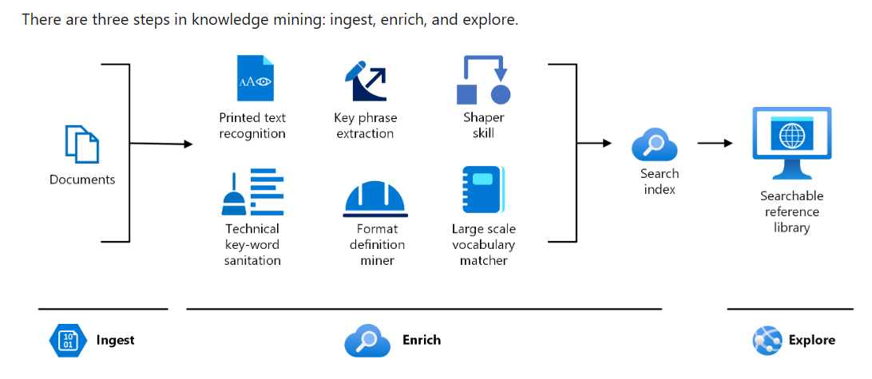
Sample Architecture: Knowledge mining for content research
Knowledge mining for content research – Azure Architecture Center | Microsoft Learn

Slide 39

Sample Architecture: Knowledge mining
Solution Accelerator Architecture
Container Registry
App Service
Web Front-end to navigate the indexed data for a search UI experience
(Continuous export to storage)
Call and Text Recordings
Storage Account
Azure Functions
Azure AI Search
Storage Accounts
As processed recordings and text-based conversations are uploaded in the storage they trigger the automatic Batch Transcription job
Each json/wav file exported to the Blob storage represents one conversation (customer to agent, voice or text chat)
The resulting transcriptions are stored in an Azure storage container along with the enriched metadata (diarization, sentiment, etc.)
OR
Azure Database for PostgreSQL
Azure Functions
Azure OpenAl Service
Key
OR
Container Registry
This is hosted externally in a different Azure resource group and is not deployed as part of the solution to the user's Azure subscription/ resource group
A set of custom and pre-built functions that implement the different use cases
Azure Al Services
Azure SQL Database
OR
Conversational Knowledge Mining Solution Accelerator GitHub
Azure Cosmos DB
This technical pattern enables customers to conduct automated knowledge mining of human conversations (call center, clinician, meetings) to gain valuable post-interaction insights and patterns.
Data may be read from a variety of data sources, including Storage Account, Azure Cosmos DB, Azure Database for PostgreSQL, or Azure SQL
Knowledge Mining

Slide 40
Content Generation
This pattern generates text or image content based on conversational user input. It combines the capabilities of Image Generation and Text Generation. The content generated may be personalized to the user.

Slide 41



Sample Architecture: Content generation
Azure
User downloads customized retailer descriptions
Function App
Storage Accounts
Storage Accounts
OR
Orchestration
OR
API
Management
Azure Database for PostgreSQL
Summarize/ Generate Content
Save Description to file
File triggers App
Azure Database for PostgreSQL
Create Prompt
OR
OR
Azure SQL Database
Azure SQL Database
OR
OR
Azure Cosmos DB
Azure Cosmos DB
Description is saved to a file in storage
Product manuals, descriptions and meta-information
Azure
OpenAI
This pattern generates text or image content based on conversational user input. It combines the capabilities of Image Generation and Text Generation. The content generated may be personalized to the user.
Data may be read from a variety of data sources, including Storage Account, Azure Cosmos DB, Azure Database for PostgreSQL, or Azure SQL
Content Generation
Notes:
Inspired by: Retail

Slide 42
Code Generation and Documentation
This pattern uses legacy code translation (GitHub Copilot) and databases, summarization for app modernization and documentation generation.

Slide 43
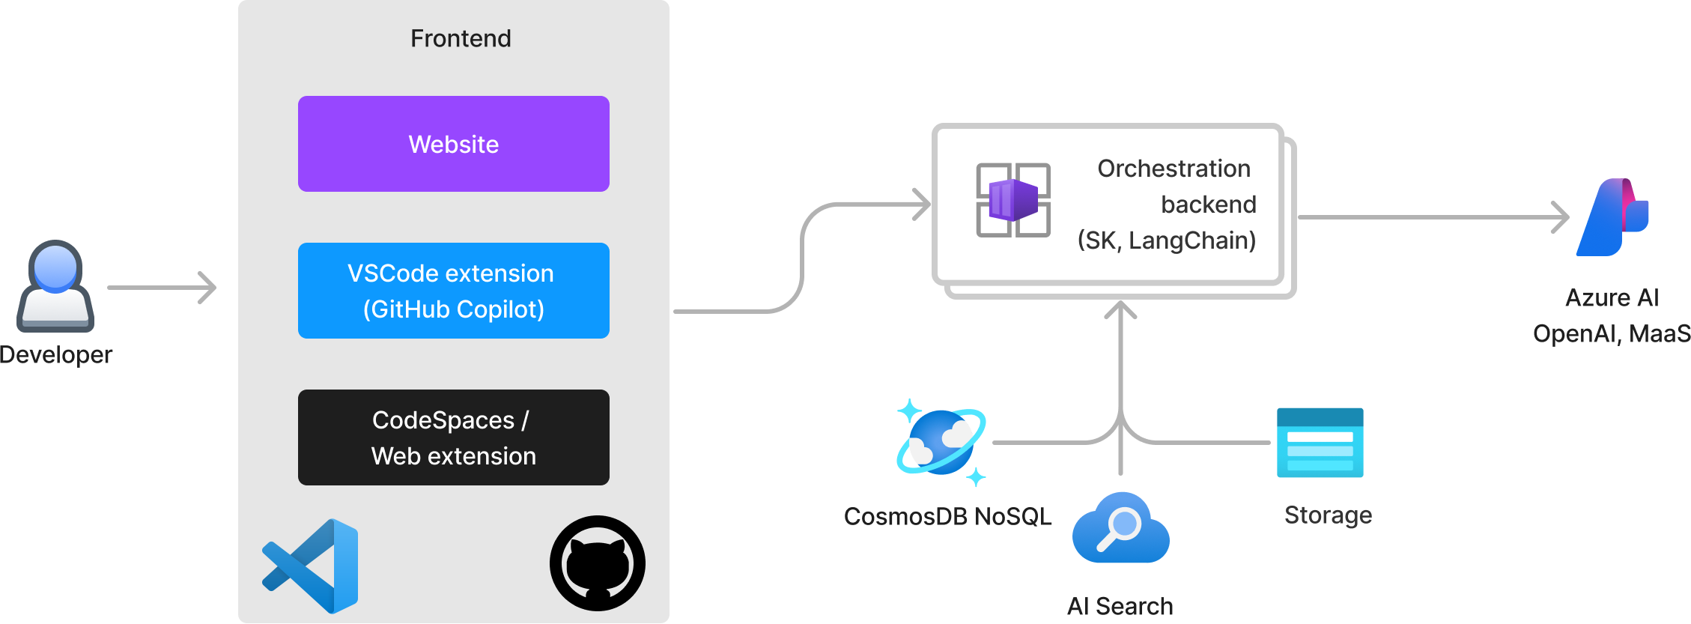
Sample Architecture: Code generation and documentation
Custom GH Copilot (Code conversion, modernization, docs etc.)
Notes:
Inspired by developer productivity and Dev workflows from actual customer deliveries (provided by Azure GBB team)

Slide 44
Personalized Recommendations
This technical pattern applies generative AI models to present content, products, or services to individual users based on multimodal inputs from text, images, and speech, and a deep understanding of customer profiles. Models themselves bring innate understanding of what these products could be (without an existing catalog).

Slide 45










Personalization and product recommendations Deliver real-time recommendations and dynamic customer experiences
Raw Data
Recommendation Engine
Offer/promo proposal
Conversational Agent
Product Inventory
Data transfer
Customer
Industry Data
Develop personalized offers & suggest promotions
Gauge customer response to offers/promos
Customer Data (Spending, Social, Demographic)
Logic Apps AKS Azure Functions
Offer/promo binary response
Bot Services
Mediated offer/promo discussion
Recommendation feedback loops
Create customer spending preferences
Azure Cosmos DB
Azure ML
Power BI Personalization
Analyst Dashboard
Personalized Recommendations
This technical pattern applies generative AI models to present content, products, or services to individual users based on multimodal inputs from text, images, and speech, and a deep understanding of customer profiles. Models themselves bring innate understanding of what these products could be (without an existing catalog).

Slide 46
Chat with your Data
This pattern combines the capabilities of document retrieval and response synthesis to create a conversational search experience for internal users.
For external users, use the “Build your own AI Assistant” pattern, which includes security controls for external access.

Slide 47

Sample Architecture: Chat with your data
Chat with your data Solution Accelerator architecture
Document ingest and management
Answering/End user
Admin UI Streamlit (Python)
Configure chunking and prompts; upload new documents
Chat Frontend (JS) + Backend (Python)
Chat interface for users
Speech Service
Chat interface for users
Storage Accounts
OR
Azure Database for PostgreSQL
Function Apps
Read files, process, chunk, embed, and store results
OR
Read documents
Ingest documents
Azure SQL Database
Azure Al Search
Stores extracted documents and embeddings
Azure Open Al Service
Reason over documented chunks
OR
Extract layout from documents
Create embeddings
Azure Al Document Intelligence
Azure OpenAl Service
Azure Cosmos DB
Chat with Your Data Solution Accelerator GitHub
Vector Search AI Assistant Solution Accelerator GitHub
Chat with your Data
This pattern combines the capabilities of document retrieval and response synthesis to create a conversational search experience for internal users.
Data may be read from a variety of data sources, including Storage Account, Azure Cosmos DB, Azure Database for PostgreSQL, or Azure SQL. Azure Cosmos DB and Azure Database for PostgreSQL can be used as a vector search engine instead of Azure AI Search. An additional reference architecture can be found in the appendix.

Slide 48
Additional Sample Architectures

Slide 49





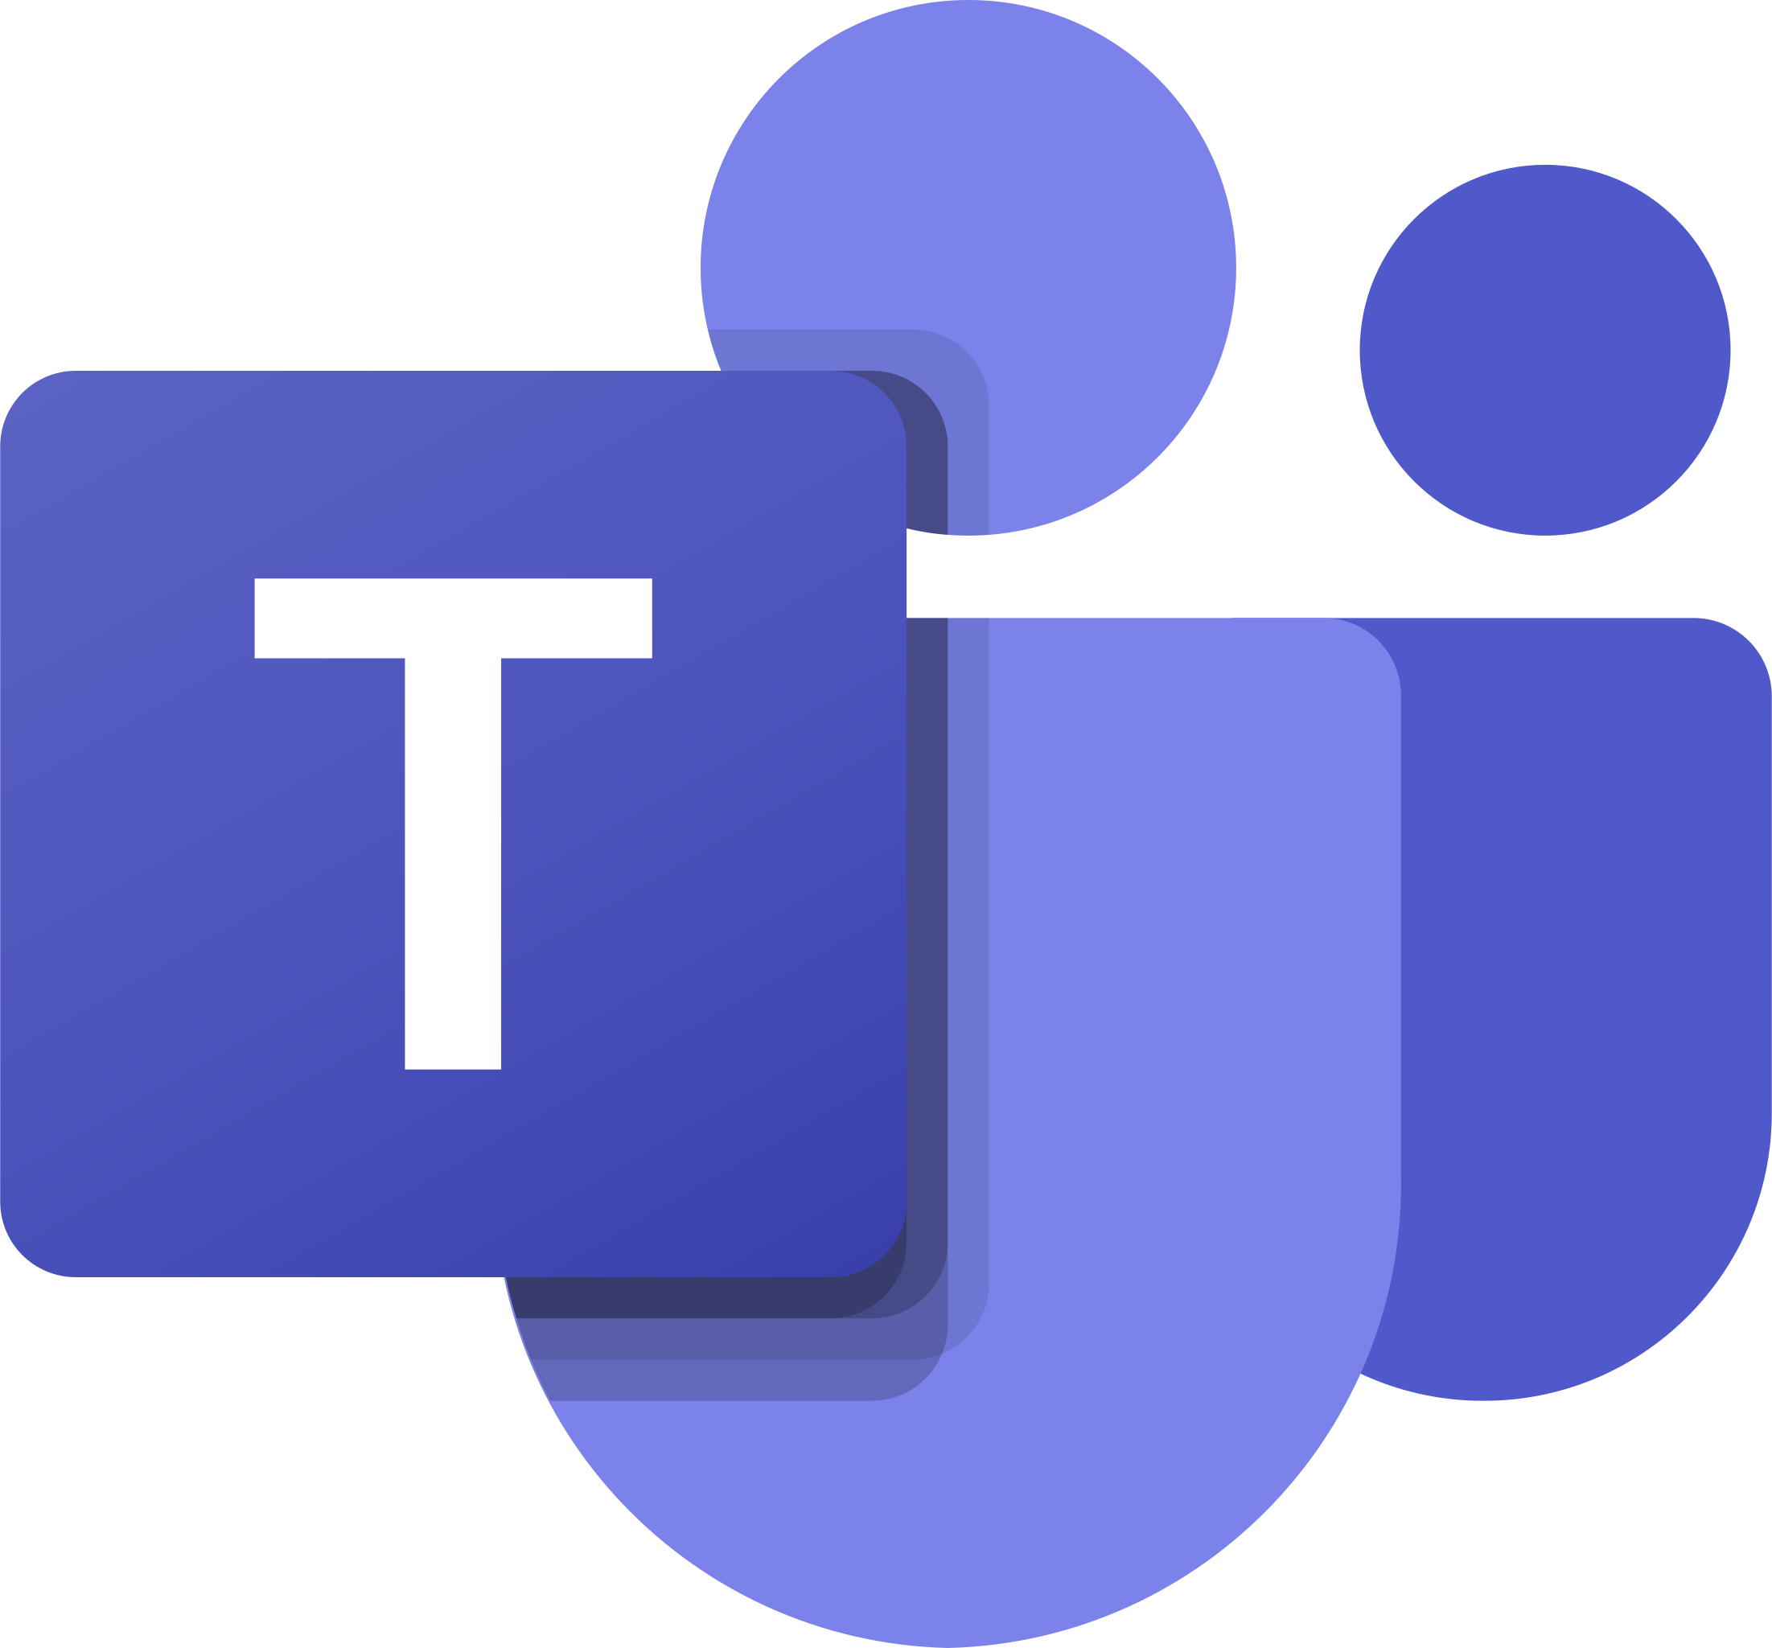



Intelligent Q&A Chatbots
PDFs
Azure
Power Platform
Extracts the data
Blob Storage
Logic Apps
AI Document Intelligence
Data ingest
Indexes the data so it is searchable
Automate Flow
Virtual Agent
Teams
AI Search
Prompt
Orchestration
Store History
Search Content
Get Response
Translate
API Management
Custom Connector
Azure OpenAI
AI Translator
Notes:
Inspired by: Manufacturing customer, Healthcare (created by Apps GBB team based on real customer projects)

Slide 50
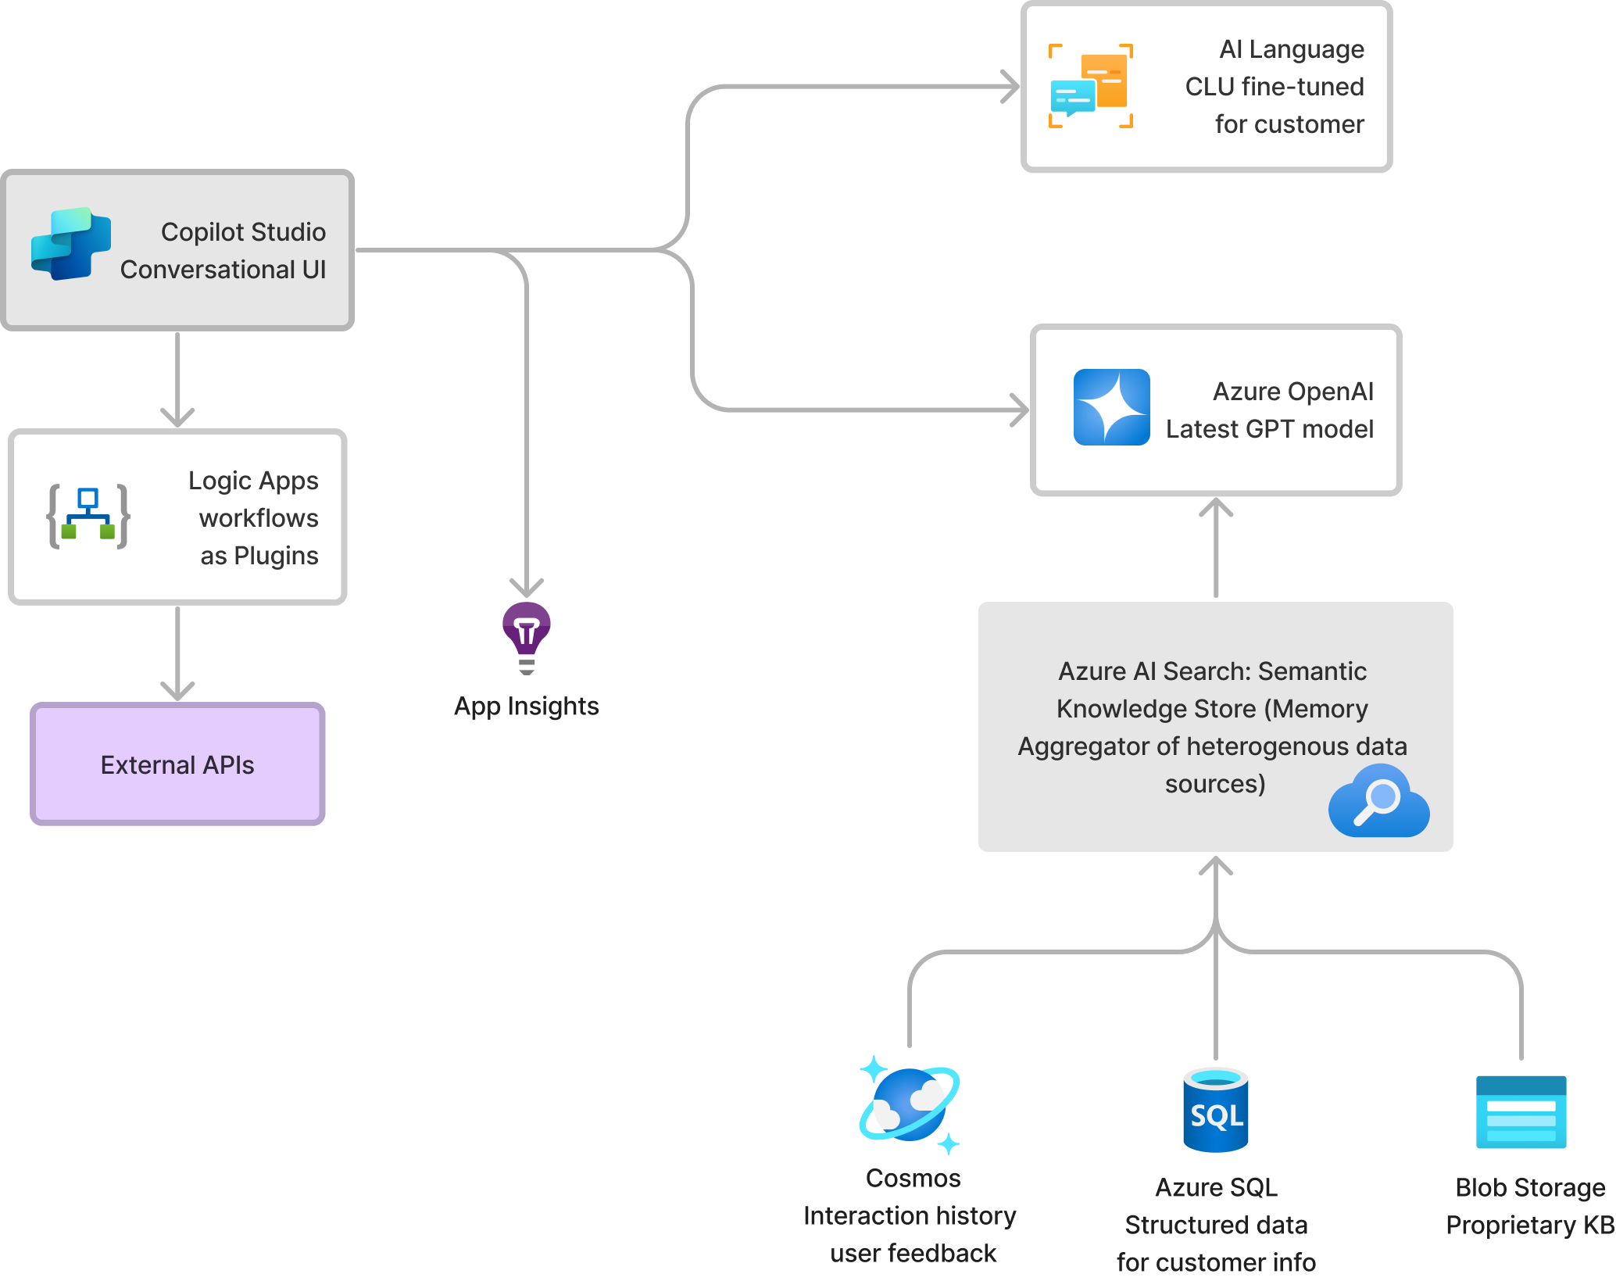
Chatbot in Copilot Studio with Azure extensibility
Notes:
Inspired by: Telecom, Media & Entertainment, SLG (created by Apps GBB team)

Slide 51
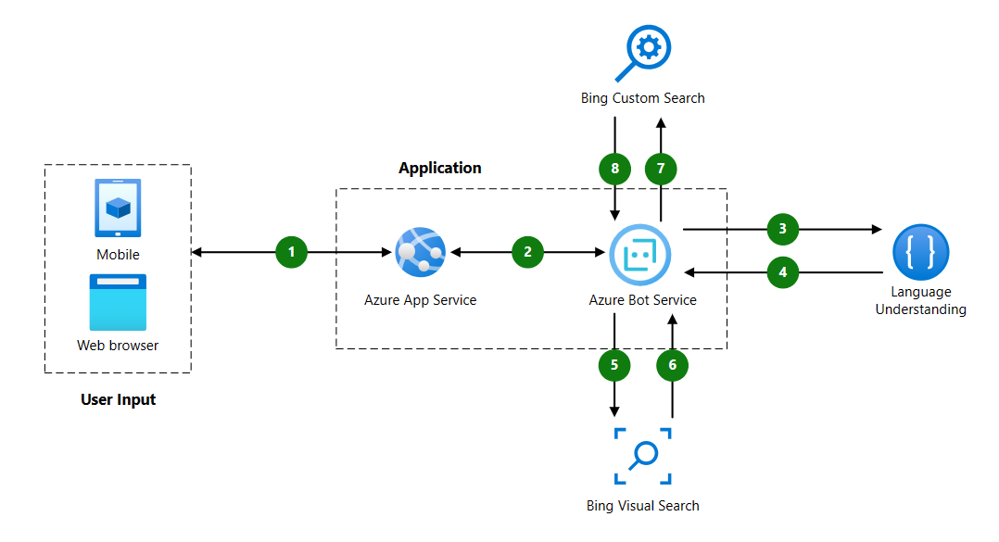
Retail assistant with visual capabilities
Retail assistant with visual capabilities – Azure Solution Ideas | Microsoft Learn

Slide 52
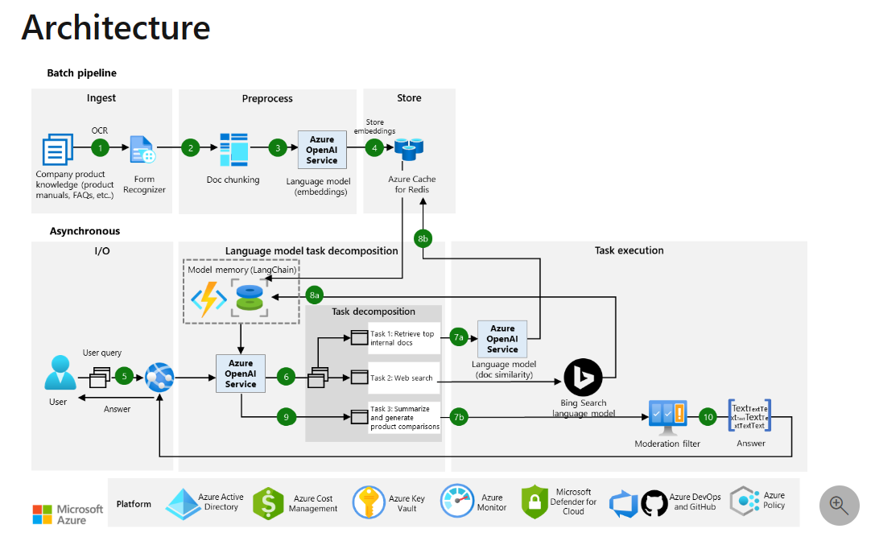
Build language model pipelines with memory
Build language model pipelines with memory – Azure Architecture Center | Microsoft Learn

Slide 53
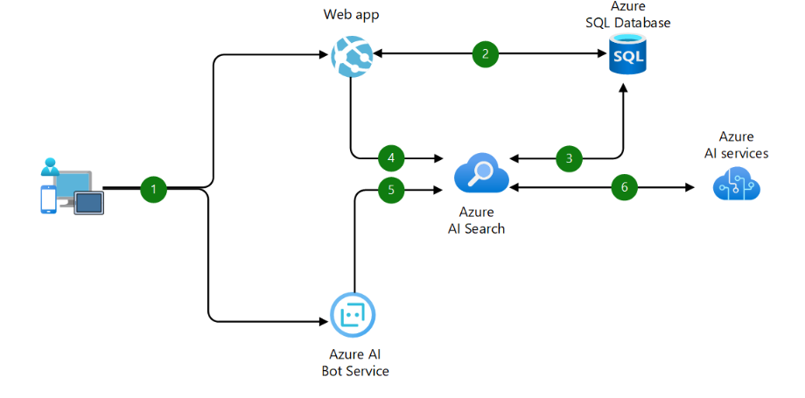
Intelligent product search engine for e-commerce
Intelligent e-commerce product search engine – Azure Architecture Center | Microsoft Learn

Slide 54
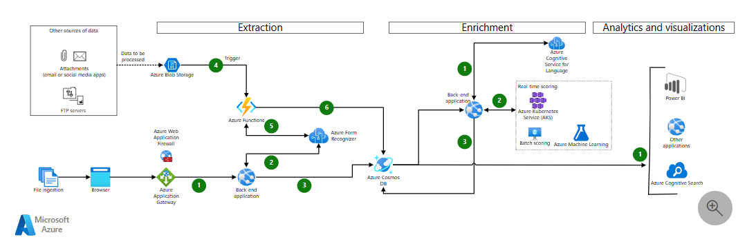
Automate document processing with Azure Form Recognizer
Automate document processing with Azure Form Recognizer – Azure Architecture Center | Microsoft Learn

Slide 55
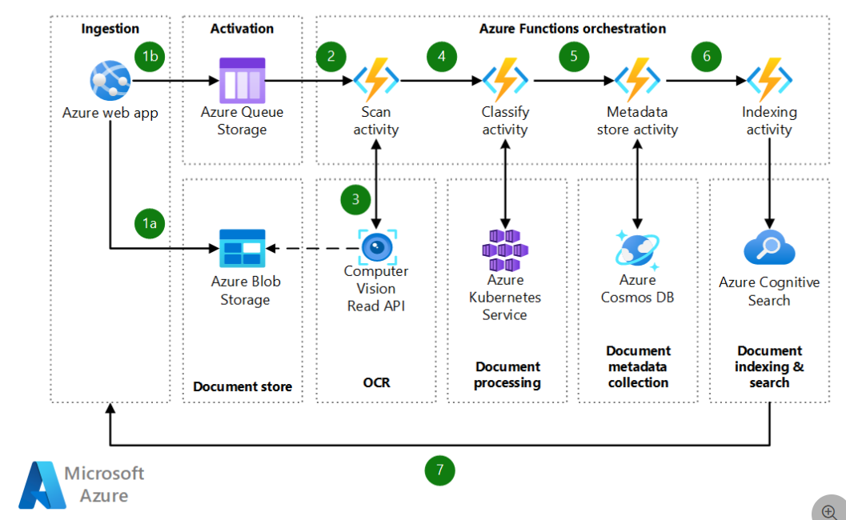
Automate document identification, classification, and search by using Durable Functions
Automate document classification in Azure – Azure Architecture Center | Microsoft Learn

Slide 56
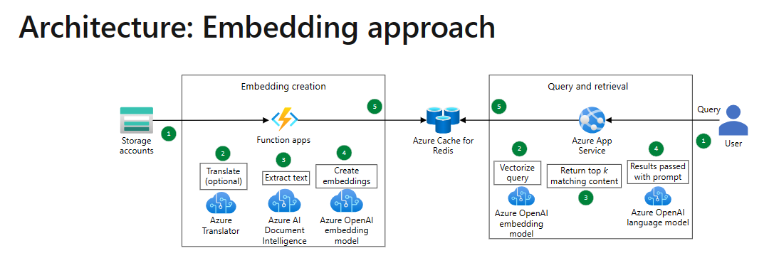
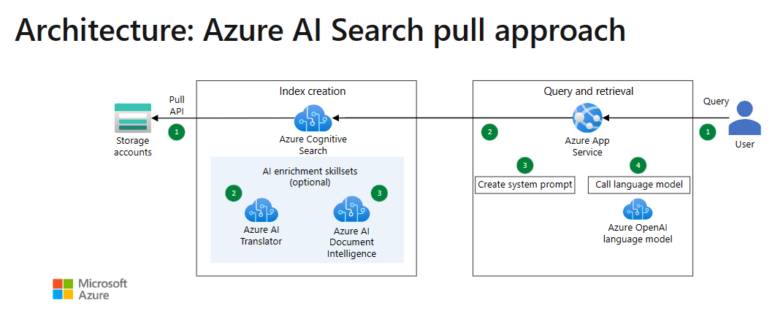
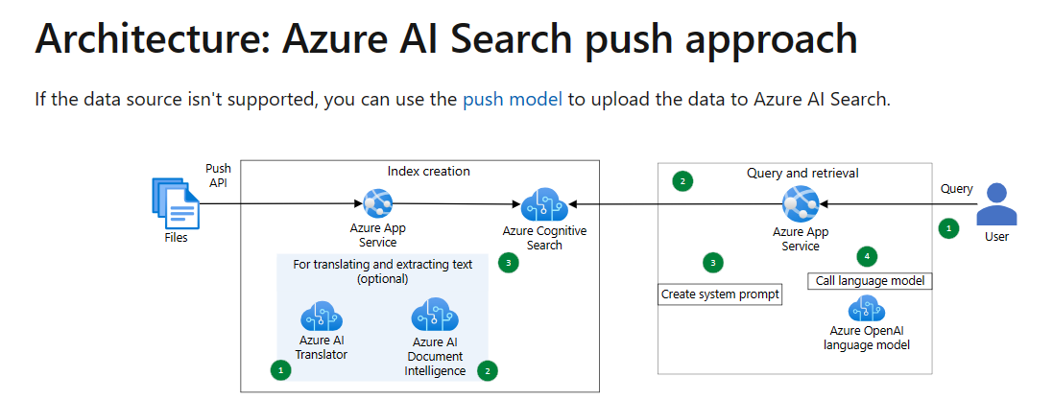
Sample Architecture: Enterprise Knowledge Base Search
Search and query an enterprise knowledge base by using Azure OpenAI or Azure AI Search – Azure Architecture Center | Microsoft Learn

Slide 57
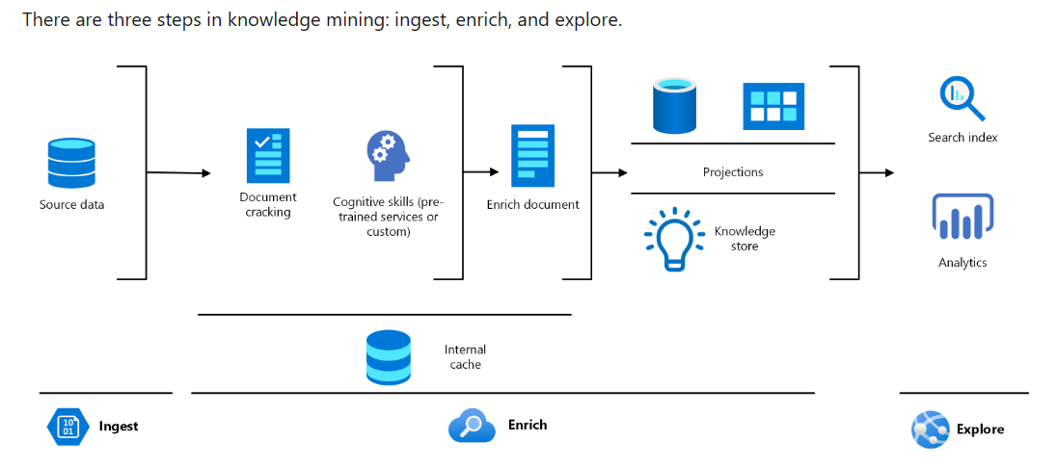
Knowledge mining for customer support and feedback analysis
Customer support and feedback analysis – Azure Solution Ideas | Microsoft Learn

Slide 58
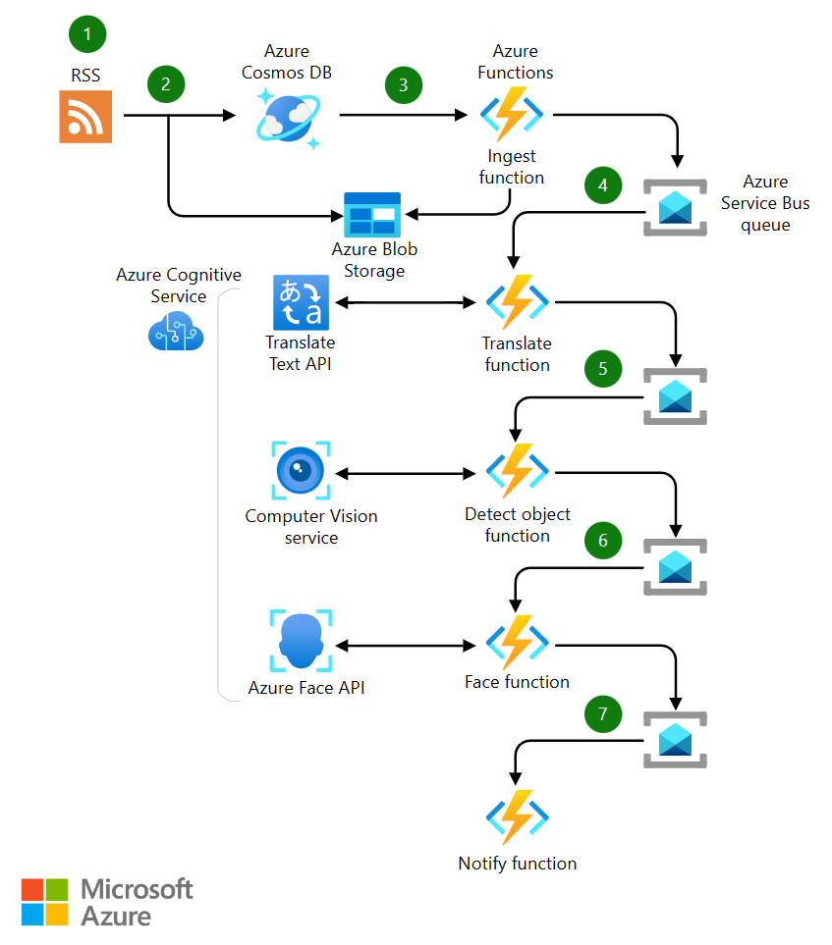
Analyze news feeds with near real-time analytics using image and natural language processing
News feeds with near real-time analytics – Azure Architecture Center | Microsoft Learn

Slide 59
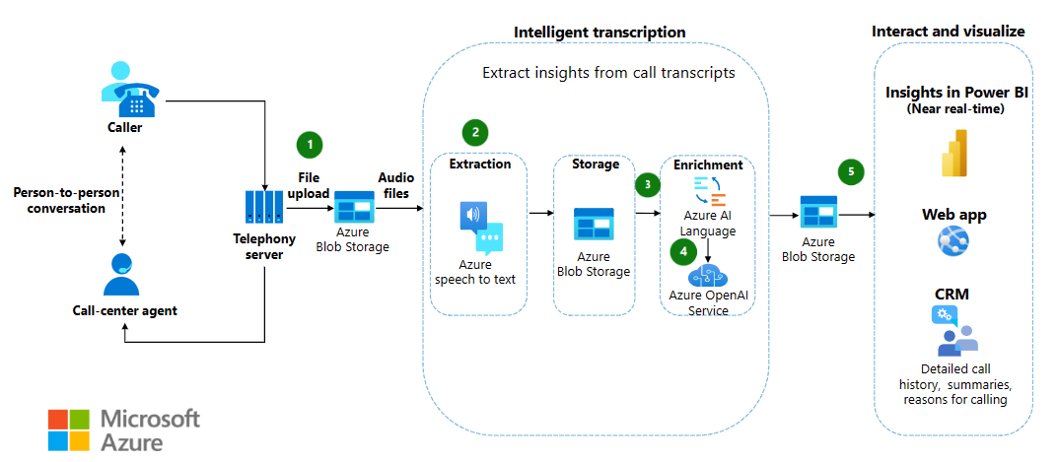
Extract and analyze call center data
Extract and analyze call center data by using Azure OpenAI Service, Speech services, and Language services – Azure Architecture Center | Microsoft Learn

Slide 60
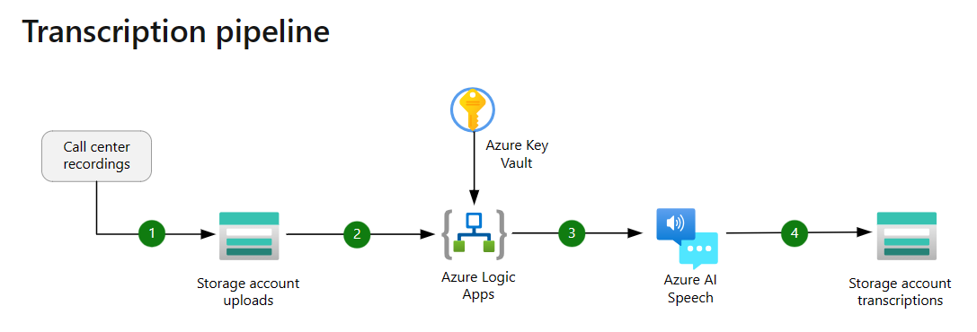
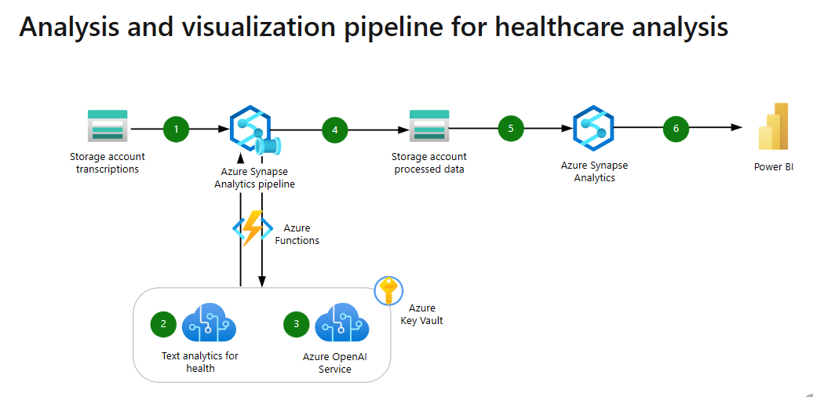
Analyze call center recordings using text analytics for health and Azure OpenAI Service
Analyze call center recordings using text analytics for health and Azure OpenAI Service - Azure Architecture Center | Microsoft Learn

Slide 61
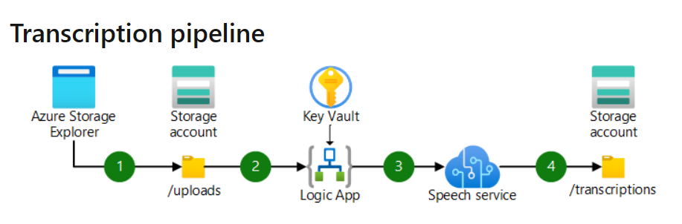
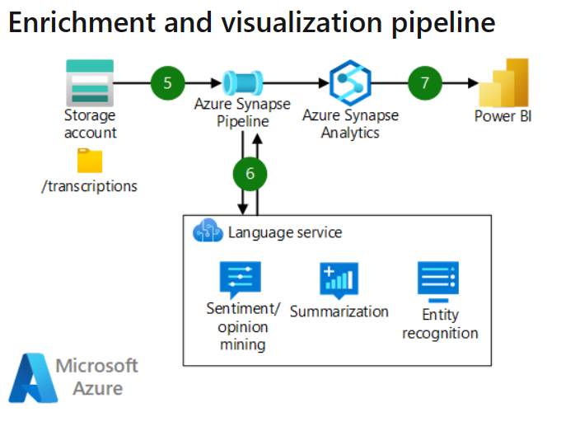
Use a speech-to-text transcription pipeline to analyze recorded conversations
Build a speech-to-text transcription pipeline to analyze recorded conversations – Azure Architecture Center | Microsoft Learn

Slide 62



Audience Content Personalization
Azure
Power Platform
Function App
Orchestration
Prompt Enrichment
Call to Generation Service
HTTP Request
Get Web Search Content
Index Data
Summarize and format response
Input Application
Get Data
User supplies parameters for marketing content
API Management
Custom Connector
Bing Search API
Database
AI Search
Azure OpenAI
Use-case: Need to be able to generate end-user personalized emails and other marketing materials using user preferences, retailer templates, and internet articles.
Solution: Employees generate content using a front-end application to specify parameters. Their input is enriched by user data, data indexed in AI Search, and the Bing API. OpenAI then summarizes this information and generates a response.
Business Impact: Increases brand value to customers by providing personalized content to each person in marketing materials and in online portals.
Notes:
Inspired by: Retail (created by Apps GBB team based on real customer projects)

Slide 63
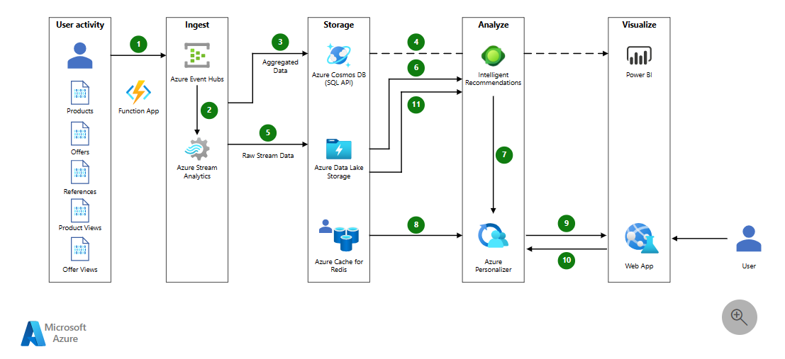
Azure Architecture Center: Personalized offers
Personalized offers – Azure Solution Ideas | Microsoft Learn

Slide 64
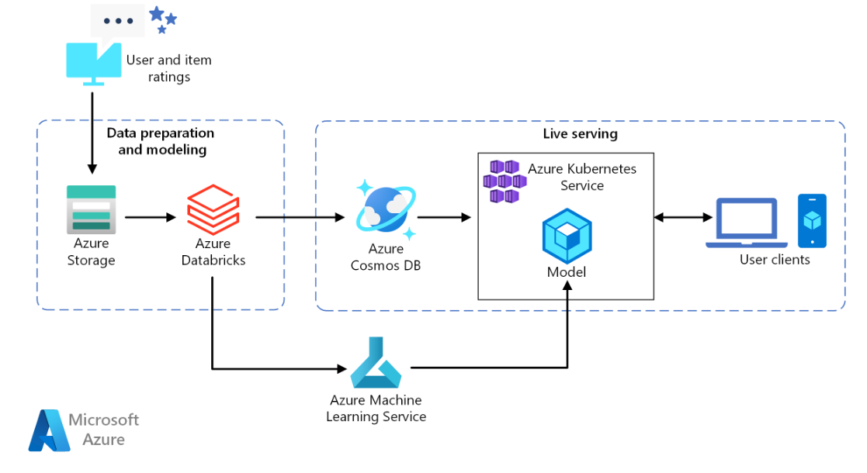
Build a real-time recommendation API on Azure
Build a real-time recommendation API on Azure – Azure Architecture Center | Microsoft Learn

Slide 65


H&R Block, FSI
PERSONAS
HR/Legal/Finance
IT
Industries:
Financial Services and Insurance
Use cases:
Document processing and workflow automation
“Give us a shoebox of tax documents, and we’ll use AI and machine learning to put the data in the right places.”
Sameer Agarwal, IT Director, H&R Block
Situation:
Solution:
Impact:
H&R Block leads the tax preparation industry; its tax professionals prepared more than 21.6 million tax returns last year. The organization wanted to spend more time understanding its clients and their unique needs, and less time on data entry and retrieval.
H&R Block turned to Azure Machine Learning and Azure AI. With Microsoft Azure Cognitive Search, each tax professional can find detailed client history in seconds. Azure Form Recognizer helps them quickly sort through stacks of forms.
With AI-powered processes in place, H&R tax professionals are finding data entry and retrieval more efficient. They can spend their time in more valuable ways: delivering differentiated client experiences and helping clients approach tax season with confidence.
Read the full story

Slide 66


Clifford Chance, Legal
PERSONAS
Legal
Industries:
Legal
Use cases:
Summarization and e-Discovery
“We’re able, using Azure OpenAI as a workflow, to package together a number of different steps to produce a whole new way of delivering what our clients need.”
Paul Greenwood, CIO, Clifford Chance
Situation:
Solution:
Impact:
For Clifford Chance, a British multinational law firm and a digitalization leader, handling text-based information securely and efficiently is crucial. Recognizing the potential of cloud computing and artificial intelligence, the firm wanted to find ways to leverage these technologies to improve employee efficiency while maintaining high levels of security and confidentiality.
The firm adopted Microsoft Translator for cognitive translation and is exploring other opportunities to use AI to improve efficiency through tools like Copilot for Microsoft 365. Building on its foundation of Microsoft Azure and Azure OpenAI, the firm is developing innovative solutions that benefit its clients, such as a new generation of large language models (LLMs).
These solutions help Clifford Chance enhance workflows and meet client needs effectively. The cognitive translation solution through Microsoft Translator has become one of the fastest-growing products. Looking ahead, Clifford Chance plans to utilize LLMs, Azure OpenAI, and Copilot for Microsoft 365 to further enhance productivity and personalize assistance.
Read the full story

Slide 67
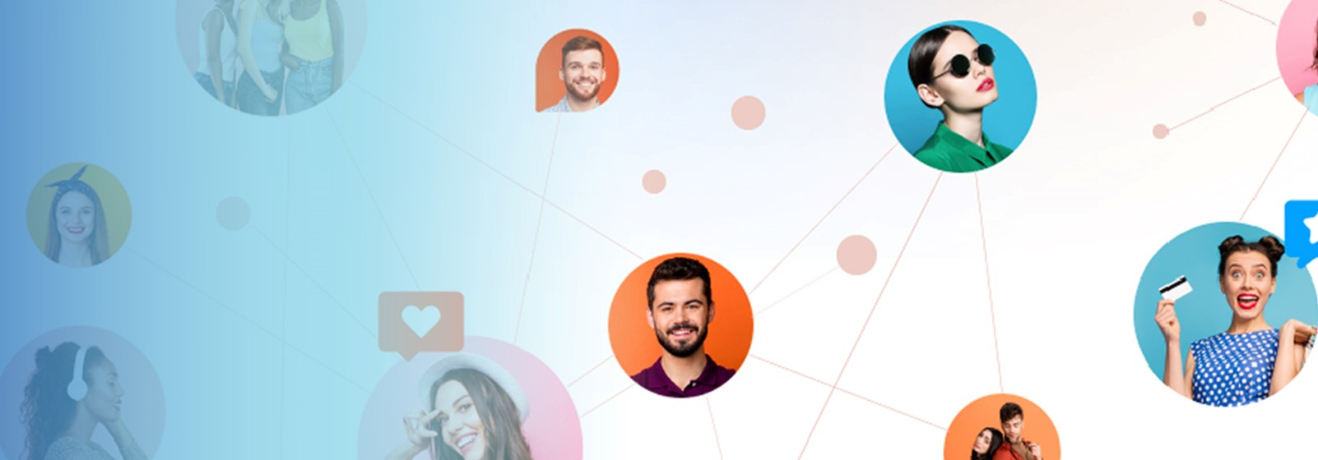

Cipio.ai, Retail and Consumer Goods
PERSONAS
Product
Marketing
Industries:
Software and Digital Platforms
Use cases:
Creation of new customer-facing content
“AI capabilities powered by Azure AI help brands drill down into specifics to find content and content creators that align with their values.”
Growson Edwards, Co-Founder & COO, CIPIO.ai
Situation:
Solution:
Impact:
With a mission to help companies connect with their communities of customers, fans, followers, and beyond to drive authentic user generated (UGC) and influence marketing content, CIPIO.ai has chosen to work with Microsoft and use Azure OpenAI Services to tap into the power of generative AI.
CIPIO.ai is using Azure OpenAI Service within multiple community commerce marketing solutions to help companies drive influence marketing, social content generation, community-generated content, and referral marketing activities. This is delivered through a generative AI application that produces social media content options derived from simple user input that can scale social media captions and textual content creation.
Jin Yu, Chief Technology Officer at CIPIO.ai says that Azure OpenAI Service gives CIPIO.ai the tools that offer customers a competitive edge in creating, organizing, and analyzing massive amounts of content, adding that the applications ingest petabytes of both first- and third-party social and consumer data reducing the amount of internal and external resources that is otherwise needed.
Read the full story

Slide 68


Modern Requirements, Government
PERSONAS
IT
Industries:
Software and Digital Platforms
Use cases:
Infrastructure as Code generation for service automation
Situation:
Solution:
Impact:
Modern Requirements wanted to help automate and optimize requirement processes to accelerate product development in industries that need to ensure regulatory compliance and auditability. Traditional methods were outdated, slow, and prone to errors, leading to a gap in the common understanding of requirements among stakeholders.
The company launched Modern Requirements4DevOps and its ChatGPT implementation, Copilot4DevOps, to automate phases in the product development life cycle. By turning Azure DevOps into a knowledge management system, the company helps users focus on collaborative tasks. Both solutions utilize Azure OpenAI’s general-purpose model, which requires little to no training to produce human-like content while ensuring data privacy and security.
These solutions have markedly improved efficiency and productivity for Modern Requirements customers, which means faster prototyping and reduced time to market. The flexibility of AI tools in handling various formats and languages has also simplified the requirements management process, making it more accessible to a wider range of users.
Read the full story

Slide 69
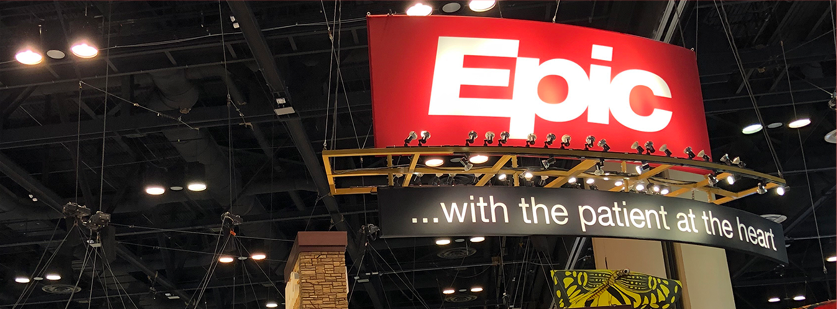

Epic, Healthcare
PERSONAS Customer Service and Support
Digital Product Owner
Industries:
Healthcare
Use cases:
Customer self-service assistant
“A good use of technology simplifies things related to workforce and workflow. Integrating generative AI into some of our daily workflows will increase productivity for many of our providers, allowing them to focus on the clinical duties that truly require their attention.”
Chero Goswami CIO, UW Health
Situation:
Solution:
Impact:
Microsoft and Epic are collaborating to develop and integrate generative AI into healthcare by combining the scale and power of Azure OpenAI Service1 with Epic’s industry-leading electronic health record (EHR) software. The collaboration expands the long-standing partnership, which includes enabling organizations to run Epic environments on the Microsoft Azure cloud platform.
Epic’s use of Azure OpenAI Service includes drafting message responses to patient inquiries, implemented with UC San Diego Health, UW Health in Madison, Wisconsin, and Stanford Health Care. Another solution will bring NL queries and interactive data analysis to SlicerDicer, Epic’s self-service reporting tool, helping clinical leaders explore data in a conversational and intuitive way.
This expanded, innovation-focused partnership between Nuance, Epic and Microsoft aims to deliver solutions to run Epic environments on Azure through a comprehensive array of generative AI-powered solutions integrated with Epic’s EHR to increase productivity, enhance patient care and improve financial integrity of global health systems.
Read the press release

Slide 70
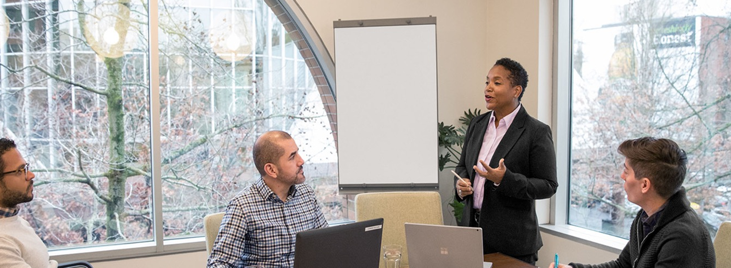

Supreme Court of Justice of the Nation of Mexico, Government
PERSONAS
Legal
Customer Service and Support
Industries:
Government
Legal
Use cases:
Virtual assistant for customers and partners
“The use of Microsoft technology has allowed us to enable open justice, where the pillars of transparency, innovation, citizen collaboration, and accountability help us be at the vanguard of Legal Tech.”
Aurelio Pedro Vázquez Sánchez, Director of Data Strategy and Digital Transformation of the General Unit for the Administration of Legal Knowledge, SCJN
Situation:
Solution:
Impact:
In 2019, Mexico’s Supreme Court of Justice of the Nation (SCJN), began an ambitious digital transformation. The court wanted to use emerging technologies to provide greater public access to its extensive archive of historical documents. Yet SCJN lacked the storage and computing power necessary to process large volumes of unstructured data.
To build its data processing and model training architecture, SCJN decided to use Microsoft Azure alongside Databricks Machine Learning. Connecting the court’s institutional data with data on the cloud allowed for the development of text classification models which resulted in a legal search engine accessible to the public.
Digitization and AI-powered processes have significantly improved public access to SCJN’s vast archive, allowing users with no legal knowledge to quickly parse more than 90,000 judgements and 300,000 theses. The project has received over 600,000 visits since its launch, aligning the court’s forward-thinking approach to legal scholarship and research with a modern, informed citizenry.
Read the full story

Slide 71


CarMax, Retail and Consumer Goods
PERSONAS Marketing and Operations
Industries:
Retail and Consumer Goods
Use cases:
Customer-facing content generation
“With the help of OpenAI Service, we’re disrupting our industry for a second time by delivering cutting-edge digital tools and capabilities and becoming a true omnichannel retailer.”
Shamim Mohammad, EVP and Chief Information and Technology Officer, CarMax
Situation:
Solution:
Impact:
With a nationwide reach and more than 45,000 cars available at any given time, helping customers do their pre-purchase research to find exactly what they need is a priority for CarMax. To help the content team organize, publish, and update this huge amount of data and information, CarMax needed an AI-based solution.
One of CarMax’s primary use cases for OpenAI is to generate text summaries for their car research pages on their website, Using Azure OpenAI Service, which gives them access to large-scale models such as GPT3, Codex, and embeddings, CarMax can accomplish this as well as achieve enterprise-grade capabilities such as security, compliance, and regional availability, using Microsoft Azure.
With OpenAI Service, CarMax is creating content for its website much more efficiently, freeing up its editorial staff to focus on producing strategic, longer-form pieces that require more insight. By generating meaningful content with appropriate keywords that customers find helpful, CarMax is boosting its search engine rankings, driving even more traffic to its website.
Read the press release

Slide 72


Providence, Healthcare
PERSONAS
Customer Service and Support
Industries:
Healthcare
Use cases:
Virtual assistant for customers and partners
“The most profound outcome is one we cannot measure and hadn’t anticipated: our caregivers have gained peace of mind… The new system means that our caregivers are helping patients who need it most. Our process is no longer getting in the way of good patient care.”
Ford Parsons, MD, Chief Operational Analytics, Providence
Situation:
Solution:
Impact:
With the growing popularity of electronic messaging between patients and caregivers, US healthcare organization Providence faced a deluge of incoming messages. This flood required triage and prevented providers from spending time with their patients.
Providence clinicians, informaticists, and AI specialists developed a new product, ProvARIA, based on Azure OpenAI Service. ProvARIA classifies messages, directs them to the appropriate caregiver, and frees providers to focus on patient.
Providence piloted ProvARIA by funneling electronics communications for four separate clinics into a centralized inbox. Medical assistants, supported by ProvARIA, worked to address the messages, handling 5,000 messages per day, resulting in a 35 percent improvement in turnaround time.
Read the full story

Slide 73


Coats Digital, Manufacturing
PERSONAS
Product Owner
Industries:
Manufacturing
Use cases:
Virtual assistant for customers and partners
“We’re very proud of our agility, and part of that agility comes from mastery of the Azure services and great relationships with Microsoft.”
Jonathan McCormack, Director of Software Engineering, Coats Digital
Situation:
Solution:
Impact:
Coats Digital, a longtime software as a service provider for the apparel industry, was looking to improve customer onboarding and navigation of its database of product information and training materials.
Coats Digital used Microsoft Azure offerings to create an AI assistant that understands questions and provides precise answers. Customers worldwide can now make the most of Coats Digital’s programs, such as its production planning tools, with natural language questions about features, documentation, order status, and more.
Launched an AI-powered assistant in six weeks
Boosted customer self-service and productivity
Reduced support burden on agents with automated handling of routine inquiries
Strengthened industry leadership via cutting-edge innovation
Read the full story

Slide 74

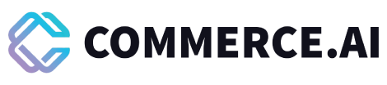
Commerce.AI, Professional Services
PERSONAS
Product Owner
Industries:
Professional Services
Use cases:
Virtual assistant for customers and partners
​“With OpenAI models, the answers to our questions are ready the moment we ask them. What we’ve done at Commerce.AI using Azure OpenAI Service is supercharge our customers’ ability to take action based on those insights through automation.” ​
Andy Pandharikar, Founder and Chief Executive Officer, Commerce.AI​
Situation:
Solution:
Impact:
​​Commerce.AI saw the potential for generative AI to disrupt businesses of all kinds and swiftly began building its own solutions to make the most of this industry-changing technology. ​
​​​​Using Microsoft Azure OpenAI Service and Azure Cognitive Services alongside its own technologies, the company has developed broadly applicable AI solutions capable of delivering actionable insights from previously hard-to-ingest unstructured video and audio data. ​
​​Customers using Commerce.AI’s solutions have reported 30 to 50 percent productivity gains and new levels of insight. Next, the company plans to empower interconnected AI workloads capable of taking on even more complex tasks, driving further benefit​.
Read the full story

Slide 75
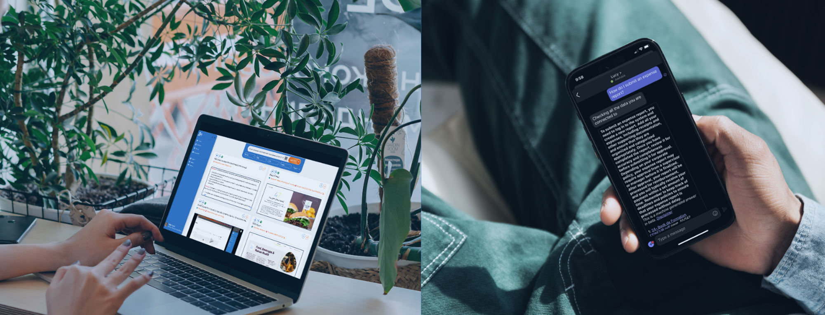

Lucy, Professional Services
PERSONAS
Digital Product Owner
Industries:
Professional Services
Use cases:
Virtual assistant for customers and partners
“My job is to create innovative apps with AI. The Azure toolset is top tier, and we at Lucy.AI are excited to explore where we can continue to evolve Lucy with a shared vision and roadmap.”
Steve Frederickson, Chief Product Officer, Lucy ​
Situation:
Solution:
Impact:
With its innovative approach to creating an “answer engine®” rather than a search engine, Lucy reinvented knowledge management, but the proliferation of unstructured data presented new challenges.
Lucy needed a modern AI solution and cloud infrastructure. It chose a suite of Azure services, including Azure AI Video Indexer, Azure Kubernetes Service (AKS), Translation, Azure OpenAI Service, Azure AI Language Studio, and Azure AI Services.
Since Lucy deployed Azure AI Video Indexer, it has been adopted by 100 percent of its customers who’ve tried the solution. Plus, Azure AI Video Indexer answers get 55 percent more engagement compared with other first-party content in Lucy.
Read the full story

Slide 76

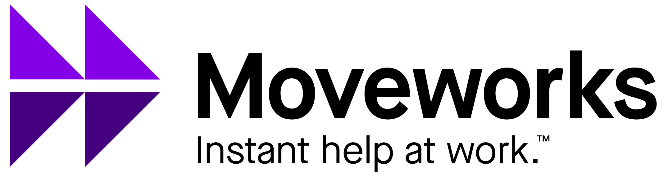
Moveworks, Professional Services
PERSONAS
HR/Legal/Finance
Industries:
Professional Services
Use cases:
Employee self-service and knowledge management
Situation:
Solution:
Impact:
Moveworks saw that many organizations were struggling to implement large language models (LLMs) effectively. And they were trying to use traditional conversational AI systems that rely on dialogue trees which often fell short resulting in frustrating user experiences. The company set out to create a solution to help organizations improve their ability to find, understand, and use data.
Moveworks created a innovative conversational AI platform that companies can use to revolutionize how their employees search for information. It leverages Azure OpenAI Service as a core component of its ML architecture, delivering advanced conversational AI powered by best-in-class LLMs and natural language understanding (NLU).
Moveworks customers can ask for assistance in natural language and receive instant, personalized support, reducing disruptions to workflow and increasing productivity. The semantic search and summarization capabilities make it easy for customers using Moveworks to anticipate and prevent problems before they occur.
Read the full story

Slide 77


Perplexity, Professional Services
PERSONAS
Product Owner
Industries:
Professional Services
Use cases:
Virtual assistant for customers and partners
Situation:
Solution:
Impact:
Perplexity is an AI-based search engine platform providing suggestions and sources in response to queries and is designed to search the web in real-time, providing up-to-date information on various topics that the user requests.
Perplexity initially developed its product using OpenAI directly; however, as its scale grew, so too did its partnership with Microsoft’s. Today, Perplexity runs all its workloads on Azure OpenAI through both our consumption model and our PTU model.
Perplexity has grown to 10M monthly active visitors and 2M unique monthly visitors and continues to grow its userbase.
Read the blog

Slide 78


Coca-Cola, Retail and Consumer goods
PERSONAS
Marketing
Industries:
Retail and Consumer Goods
Use cases:
AI-enabled marketing content generation
Situation:
Solution:
Impact:
Coca-Cola wanted to leverage the massive potential of OpenAI’s generative AI technology to enhance its marketing and consumer experiences—and also explore ways to improve business operations and capabilities.
Coca-Cola is using GPT-4 to power its internal productivity chatbot for a ChatGPT-like experience. Additionally, Coca-Cola is using GPT-4 models for its knowledge hub, which leverages Azure Cognitive Services along with Azure OpenAI to answer questions on their data.
Coca-Cola is looking to build a Marketing POC that will integrate digital marketing with Open AI, enhancing the content generation experience. Leveraging the capabilities of GPT-4 for innovative marketing solutions has also opened exciting possibilities for Coca-Cola in organizational and business growth.​
Read the press release

Slide 79


Yobi, Professional Services
PERSONAS
Marketing and Operations
Industries:
Partner Professional Services
Use cases:
Continuous customer micro-segmentation
“Yobi wouldn’t exist today if it weren’t for the partnership, leadership, and support that Microsoft has provided us.”
Max Snow, Cofounder, Yobi
Situation:
Solution:
Impact:
Yobi, in partnership with Microsoft, is on a mission to help businesses compete with large companies by forging a new path forward when it comes to customer behavioral data.
Yobi build the largest consented predictive behavioral graph in the US to date using Azure Data Services to facilitate cross- and co-selling opportunities for organizations that span multiple industries, including Consumer product goods (CPG), insurance, media and entertainment, eCommerce, and manufacturing.
CPG: Delivered a 30X lift in ROAS at 1/6th the costs for Oscar Meyer.
Insurance: Increased website conversions 3X for a Fortune 100 Insurance Company.
Media and entertainment: Increased tune-in by 500% for a cable network.
More results in the slide notes.
Read the full story
Notes:
YOBI NOTES TO SAVE: Yobi notes eCommerce: Replicated the performance of Facebook Ads programmatically, enabling eCommerce companies to decrease their CPA/CAC by over $100 outside of Facebook.
B2B/Manufacturing: Decreased CPA by 11X and increased CTR by 15X for a Global Electronics Parts Distributor.

Slide 80

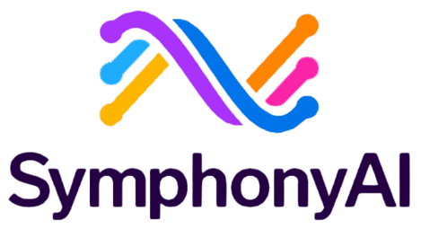
SymphonyAI, Retail and Consumer Goods
PERSONAS
Digital Product Owner
Industries:
Retail and Consumer Goods
Financial Services and Insurance
Use cases:
Virtual assistant for customers and partners
“Our mission, together with Microsoft, is to provide valuable AI applications to businesses, and in this case, to work together in partnership to create a fraud-free future.”
Kumar Abhimanyu, Senior Vice President and Global Head of Strategic Partnerships, SymphonyAI
Situation:
Solution:
Impact:
SymphonyAI needed a solution for banks and other financial institutions to detect, assess, and report financial crime—and saw an opportunity to transform the industry with AI. By integrating AI and machine learning, the company identifies areas of previously undetected risk so investigators can do their jobs more efficiently and effectively.
SymphonyAI introduced Sensa Copilot, a sophisticated AI assistant that incorporates Microsoft Azure OpenAI Service, to uniquely combat financial crime. The AI-based criminal discovery techniques of the SymphonyAI Sensa-NetReveal platform, combined with the generative AI-based Sensa Copilot, offer a critical advantage to fraud and financial crime units.
This AI-driven solution empowers financial crime investigators to quickly identify criminal behavior, with Investigations predicted to be completed 60% – 70% faster. It has also increased the productivity of a financial institution’s compliance department by about 60%.
Read the full story

Slide 81


Coursera, Education
PERSONAS
Marketing
Industries:
Education
Use cases:
Virtual assistant for customers and partners
Situation:
Solution:
Impact:
As a learning platform, Coursera is working to build generative AI capabilities into the end-user experience that will support a customized learning experience through every course. Coursera’s goal is to meet users wherever they stand in their learning journey and provide tools to help them achieve their learning goals.
To hyper-personalize the user learning experience, Coursera released Coursera Coach, an AI tutor. With Coursera Coach, users can leverage the power of Azure OpenAI to receive personalized feedback on their learning progress, suggestions for additional content to support concept mastery, and interactive Q&A capabilities to assess conceptual understanding.
Coursera’s solution is creating unique value for learners as they embark on cultivating new skills by using the power of Azure OpenAI. Continuing in their journey to build personalized learning experiences, Coursera plans to build upon the work of Coursera Coach with AI-powered features, such as Coursera Author, for streamlined course content generation built on Azure OpenAI.
Read the blog

Slide 82


Etsy, Retail and Consumer Goods
PERSONAS
Marketing
Customer Service and Support
Industries:
Retail and Consumer Goods
Use cases:
Personalized shopping assistant
AI-generating marketing content
Situation:
Solution:
Impact:
Etsy, Inc. is an American e-commerce company focused on handmade or vintage items and craft supplies. These items fall under a wide range of categories, including jewelry, bags, clothing, home décor and furniture, toys and art as well as craft supplies and tools. As of December 31, 2022, Etsy had over 100 million items in its marketplace.
In the existing solution, Azure OpenAI powers Etsy’s virtual shopping assistant. Buyers prompt the shopping assistant which will help them navigate Etsy by making product recommendations. Etsy will conduct a phased release for mobile users before wider footprint releases.
With the advances in LLMs and implementations such as ChatGPT, Codex, and Embeddings models, these advances will enable various NLP solutions to understand, converse, and generate content. Users will be able to access the service through REST APIs, SDKs, and Azure OpenAI Studio.
Read the blog

Slide 83
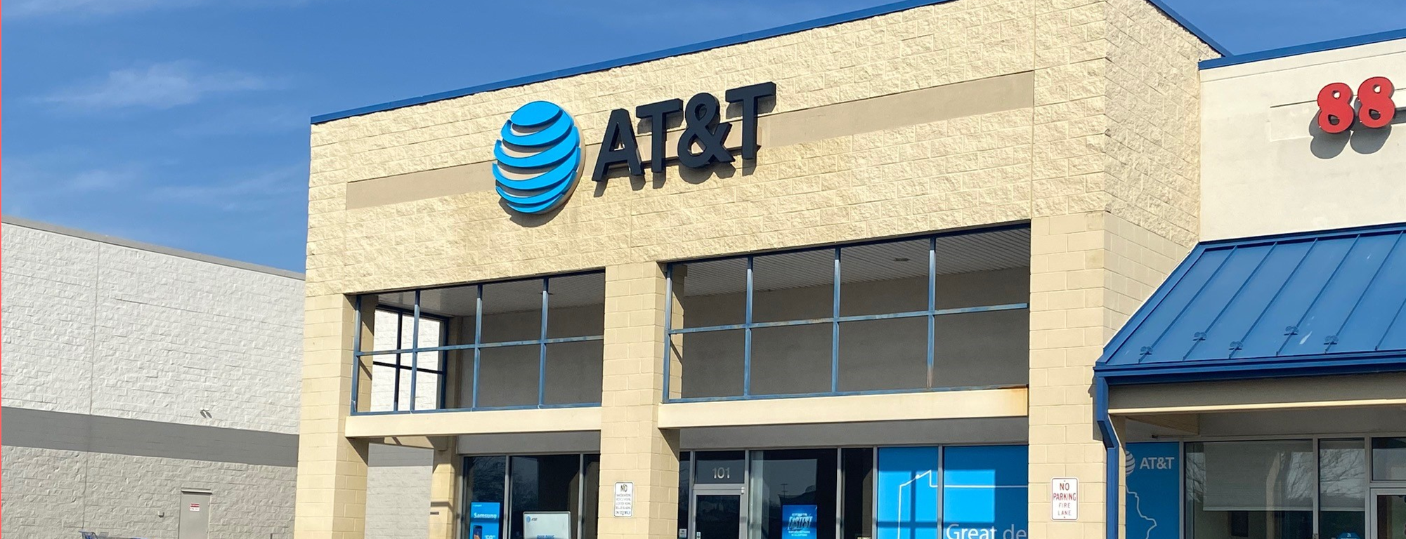

AT&T, Telecomm
PERSONAS
Customer Service and Support
Industries:
Telecomm
Use cases:
Contact center agent assistant
“Once they (the AT&T developer base) realize what it can do, they love it”
- Mark Austin, Vice President, Data Science, AT&T
Situation:
Solution:
Impact:
AT&T wanted to use AI to automate some business processes and improve employee experiences. In particular, the development team needed a way to enable IT service requests, migrate legacy code into modern code, improve code reliability, and speed up time to production.
AT&T uses Microsoft Azure OpenAI Service to create an AI assistant, Ask AT&T, which helps its developers automate their coding process. AT&T’s customer service representatives also began using the chatbot to help summarize call transcripts generated from customer support calls.
AT&T’s Ask AT&T AI assistant helps employees finalize enterprise forms that once took hours to complete. Now, it takes just two minutes. This allows employees to focus on other, more complicated tasks. Developer productivity has increased up to 50% in some cases while using the chatbot solutions. This effort helped AT&T leverage chatbots and OpenAI technology to improve productivity.
Read the full story
Notes:
AT&T NOTES TO SAVE: AT&T is using Microsoft Azure OpenAI Service in a few different use cases:
To enable IT professionals to request resources like additional virtual machines when they are running out of storage or if they are having a computer problem.
To migrate legacy code into modern code, which will help accelerate developer’s productivity and let them to focus on creating more modern tools and experiences for AT&T customers and employees.
To empower employees to complete common human resources tasks, such as changing withholdings, adding a dependent to an insurance plan, or requisitioning a computer for a new hire. Employees can ask ChatGPT in Azure OpenAI Service a question or give it a command and the task is passed on to the appropriate person on the employee’s behalf.

Slide 84

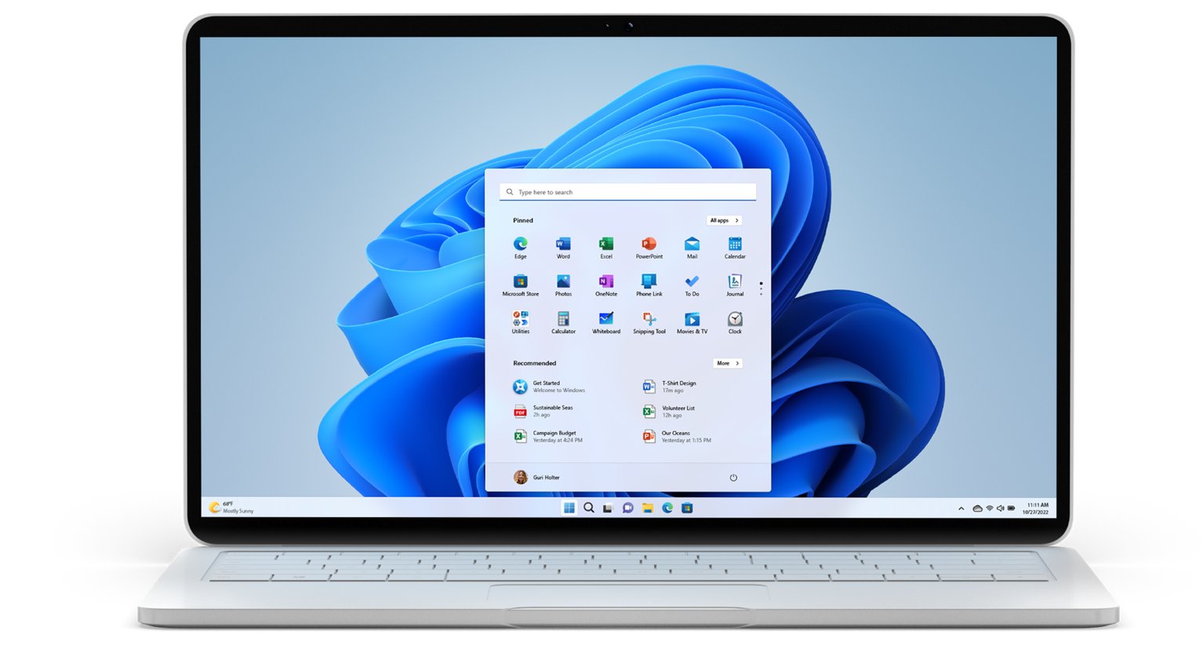
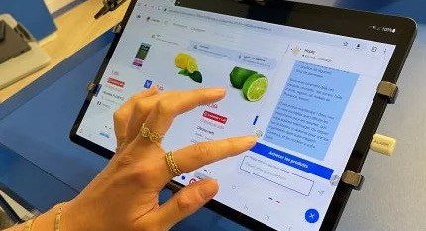
Revolutionizing grocery shopping with gen AI
Read full story >
Notes:
Carrefour, in collaboration with Microsoft and Bain, is deploying three innovative tech solutions based around ChatGPT technology: an advice robot for shopping on carrefour.fr, description sheets for Carrefour brand products on its website and support for purchasing procedures. These solutions are based on OpenAI technologies, particularly GPT-4.
Using natural language, customers can get help to choose products for their basket based on their budget, food constraints, or menu ideas. The chatbot can also suggest anti-waste solutions for reusing ingredients, provide relevant recipes and suggest other ingredients. The chatbot is connected to the site’s search engine and offers customers lists of products related to what they’re discussing right up until they make their purchase.
https://www.carrefour.com/en/news/2023/carrefour-integrates-openai-technologies-and-launches-generative-ai-powered-shopping

